Slide 1
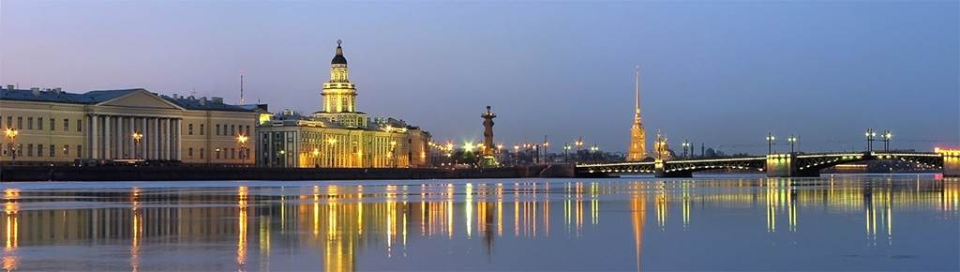
Ultrametricity in the context of biology
Theory and Modeling of Complex Systems in Life Sciences,
St. Petersburg, 18-21 September, 2017
Vladik Avetisov
The Semenov Institute of Chemical Physics of the Russian Academy of Sciences, Moscow

Slide 2
Why can the ultrametric be interesting for the life sciences?
Typically, the biological systems are characterized by tremendous amount of possible states and extremely rugged landscapes of control functions.
Typically, such systems are referred as complex systems.
Typically, the modeling of complex systems suggests some tricks that simplify the description, but keep the complexity.
Sometime, ultrametric geometry is such a trick.
Notes:
Some people believe that the ultrametric is an exotic metric having nothing to do with the real world. I do not think so. For complex systems, which are characterized by astronomically large number of states and strongly rugged landscapes of control functions, ultrametric geometry is often tern out more usable than Euclidian geometry.
This is the main thesis of my lecture, and the lecture itself consists of some illustrations of this thesis related to biology.

Slide 3
What I'll talk about.
General
Metric and ultrametric
Random walk in an ultrametric space
Models
Ultrametricity generated by random branching in a high-dimensional Euclidean space
Ultrametric representation of complex landscapes
Ultrametricity of sparse random networks
Protein ultrametricity

Slide 4
Metric
4/35
General: Metric and ultrametric
Distance in an Euclidean space is an example.

Slide 5
Geometry of the triangle inequality
5/35
General: Metric and ultrametric
triangle inequality:
there can be any triangle
equilateral
isosceles
different sides
r
Any ball has a unique center
x₀
A long distance can be passed by short steps (Archimedes axiom)
Two balls may partly overlap
Due to the triangle inequality, the distance can grow continuously and can be measured by a tape-line.

Slide 6
Numerical description of Euclidean spaces
6/35
General: Metric and ultrametric
Archimedes principle
triangle inequality
integers, N
numeric norm, |x|, x∈Q
metric
Euclidean space is described by the field of real numbers R
rational numbers, Q
Euclidean space
Models
real numbers, R
All series that converge in the real norm form the field of real numbers R
Real numbers are "real" (measurable) just because of Archimedes axiom

Slide 7
Ultrametric
7/35
General: Metric and ultrametric
Triangles with different sides are forbidden. There can be only equilateral and isosceles triangles (with smaller basis)
equilateral
isosceles
different sides
This "amendment to the law" dramatically changes the geometry

Slide 8
Ultrametric
General: Metric and ultrametric
Archimedes axiom is not satisfied.
A long ultrametric distance can not be passed by short steps. With any number of steps, the path length will not exceed the largest step.
A way passed by identical steps lies entirely in an ultrametric ball with radius r equal to a step length.
In particular, diameter of any ultrametric ball is equal to its radius.
Ultrametric distance can not be measured by a tape-line.

Slide 9
Ultrametric geometry
9/35
General: Metric and ultrametric
Any ball has a unique center
Any point of an ultrametric ball is its center
Two balls may partly overlap
Ultrametric balls can not overlap partially.
If two balls have a common point, the smaller ball is completely embedded into the larger one, and the common point is a center.
With respect to distance, non-intersecting ultrametric balls form the equivalence classes.

Slide 10
Ultrametric geometry
10/35
General: Metric and ultrametric
Due to strong triangle inequality, ultrametric distance between two non-intersecting balls is greater than the radius of the largest of them.
B₂
B'₁
{y}
The ultrametric distance can not change continuously. It can only take discrete values: the longer the distance, the bigger a jump that is needed to increase the distance.
B₁
{x}
Any ultrametric ball can be completely covered by a finite number of non-intersecting smaller balls.

Slide 11
Tree-like presentation of an ultrametric space
11/35
General: Metric and ultrametric
Ultrametric space can be represented by a tree-like hierarchy of balls embedded in each other.
d₃
r₃
d₂
d₂
r₂
r₁
d₁
d₁
The points of an ultrametric space are represented by the leaves at the border of the tree, while the distances between the points are given by the tree itself according to the hierarchy of ultrametric balls embedded in each other.
Translational invariant ultrametric space is represented by a regularly branching tree.

Slide 12
Ultrametric distances
12/35
General: Metric and ultrametric
Matrix of ultrametric distances has a characteristic block-hierarchical form.
d₃
d₂
d₂
d₁
d₁
The data represented by a block-hierarchical matrix suggests ultrametricity.

Slide 13
p-adic norm
13/35
General: Metric and ultrametric
Just as for real numbers, the field of p-adic numbers, Q_{p} , is the completion of rational numbers by all series converging in the p-adic norm.
Fractional parts of p-adic numbers are finite.
Integer parts of p-adic numbers can be infinite.

Slide 14
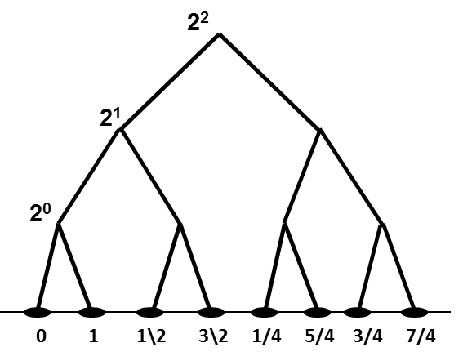
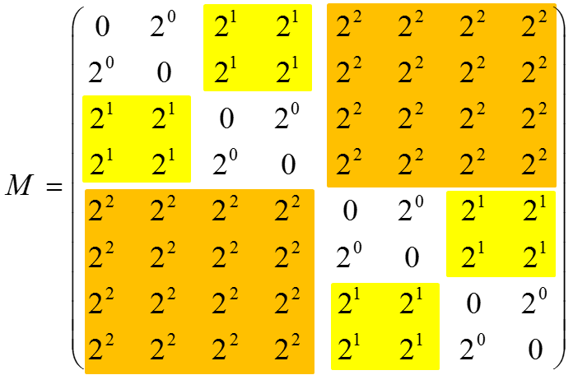
Ultrametric distance as the p-adic norm
14/35
General: Metric and ultrametric
tree of ultrametric distances
matrix of ultrametric distances

Slide 15
Ultrametric space is described by p-adic numbers
15/35
General: Metric and ultrametric
strong triangle inequality
integers, N
p-adic norm, |x|, x∈Q
metric
rational numbers, Q
Ultrametric space
ultrametric models
p-adic numbers, Q_{p}

Slide 16
Random branching in a high-dimensional Euclidean space
16/35
Models: Ultrametricity generated by random branching
(0)
a
a
σ
σ
x₁
x₂

Slide 17
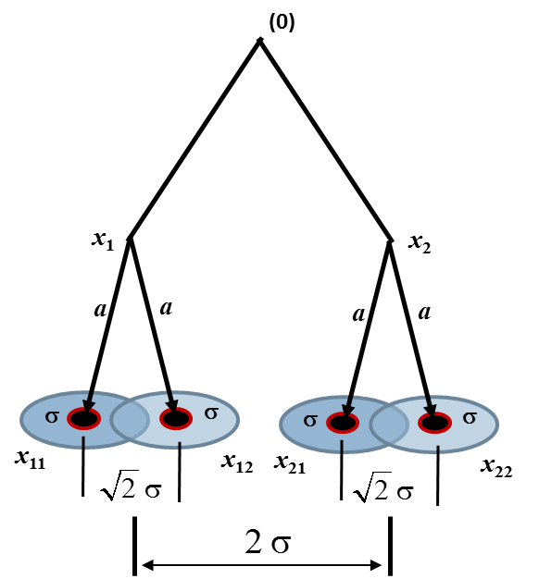
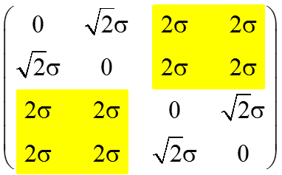
Random branching in a high-dimensional Euclidean space
17/35
Models: Ultrametricity generated by random branching
Tree of ultrametric distances
These distances satisfy the strong triangle inequality, i.e. the Euclidian distances between random points generated by a branching-like procedure converges to ultrametric distances as D → ∞ .
Block-hierarchical matrix of ultrametric distances

Slide 18
Random branching in a high-dimensional Euclidian space
18/35
Models: Ultrametricity generated by random branching
Zubarev A. P., 2014, arXive:1311.5094v4
The ultrametricity arises due to the fact that as soon as two branches of the branching process diverge, they never come close to each other in an Euclidean space of high dimension.

Slide 19
Matrix of distances
Random branching in a high dimensional Euclidean space: numerical experiment
Models: Ultrametricity generated by random branching
N=10
p=2, σ=10, m=3
0 | 9.33 | 19,52 | 19.01 | 26.37 | 27.45 | 21.24 | 29.58
9.33 | 0 | 16.28 | 16.21 | 25.49 | 24.86 | 20.88 | 28.60
19,52 | 19.01 | 0 | 7,41 | 29.44 | 28.84 | 27.86 | 31.32
16.28 | 16.21 | 7.41 | 0 | 25.08 | 24.58 | 24.81 | 27.92
26.37 | 27.45 | 21.24 | 29.58 | 0 | 8,76 | 20.26 | 19.27
25.49 | 24.86 | 20.88 | 28.60 | 8.76 | 0 | 17.55 | 17.29
29.44 | 28.84 | 27.86 | 31.32 | 20.26 | 19.27 | 0 | 16.60
25.08 | 24.58 | 24.81 | 27.92 | 17.55 | 17.29 | 16.60 | 0
(A. P. Zubarev, p-Adic Numbers, Ultrametric Analysis, and Applications, 2014, 6 (2), 155; arXiv:1509.01407)
N→∞
N=1000
0 | d₁ | d₂ | d₂ | d₃ | d₃ | d₃ | d₃
d₁ | 0 | d₂ | d₂ | d₃ | d₃ | d₃ | d₃
d₂ | d₂ | 0 | d₁ | d₃ | d₃ | d₃ | d₃
d₂ | d₂ | d₁ | 0 | d₃ | d₃ | d₃ | d₃
d₃ | d₃ | d₃ | d₃ | 0 | d₁ | d₂ | d₂
d₃ | d₃ | d₃ | d₃ | d₁ | 0 | d₂ | d₂
d₃ | d₃ | d₃ | d₃ | d₂ | d₂ | 0 | d₁
d₃ | d₃ | d₃ | d₃ | d₂ | d₂ | d₁ | 0
0 | 14.13 | 19.59 | 19.86 | 24.60 | 23.93 | 25.14 | 24.90
14.33 | 0 | 19.93 | 19.93 | 24.56 | 24.31 | 25.41 | 24.89
19.59 | 19.86 | 0 | 14.22 | 24.69 | 24.74 | 24.92 | 24.19
19.93 | 19.93 | 14.22 | 0 | 23.75 | 24.04 | 24.28 | 24.19
24.60 | 23.93 | 25.14 | 24.90 | 0 | 14.33 | 19.52 | 19.88
24.56 | 24.31 | 25.41 | 24.89 | 14.33 | 0 | 19.37 | 19.46
24.69 | 24.74 | 24.92 | 24.19 | 19.52 | 19.88 | 0 | 14.01
23.75 | 24.04 | 24.28 | 24.19 | 19.37 | 19.46 | 14.01 | 0

Slide 20
Remark
Models: Ultrametricity generated by random branching
A subset generated by random branching in a high dimensional Euclidean space typically shows ultrametricity.
Ultrametricity arises due to the fact that as soon as two branches of the branching process diverge, they never come close to each other in an Euclidean space of high dimension.

Slide 21
Ultrametric random walk
21/35
General: Random walk in an ultrametric space
block-hierarchical matrix of ultrametric distances
block-hierarchical matrix of transition rates
p-adic master equation
x
In fact, ultrametric random walk is a family of random processes specified by different functions ρ(|x-y|_{p}).

Slide 22
Cauchy problem and survival probability
22/35
General: Random walk in an ultrametric space

Slide 23
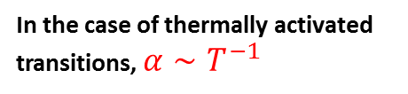
Characteristic relaxations
23/35
General: Random walk in an ultrametric space
Transition rates decreases with ultrametric distance as a power function
Survival probability:
In the case of thermally activated transitions, $α∼T^{−1}$
First passage time distribution:
Long-time behavior obeys the power relaxation

Slide 24
Characteristic relaxations
24/35
General: Random walk in an ultrametric space
Transition rates decreases with ultrametric distance logarithmically
Survival probability:
Long-time behavior obeys the stretched exponent relaxation
(the Kohlrausch-Williams-Watts law)

Slide 25
Characteristic relaxations
25/35
General: Random walk in an ultrametric space
Transition rates decreases with ultrametric distance exponentially
Survival probability:
Long-time behavior obeys the logarithmic relaxation.

Slide 26
Remark
26/35
General: Random walk in an ultrametric space
"Ultrametric random walk" may be used for modelling the random processes with different long-time behavior.

Slide 27
Complex landscape as a tree of basins of minima
Models: Ultrametric representation of complex landscapes
Clustering the local minima into hierarchically nested basins of minima with respect to the barriers (transition rates) between them
Tree-like "skeleton" of basins on complex landscape
energy
The leaves on the boundary of a three (the local energy minima) are the system states. Any subtree is a basins of minima, and the branching points specify the distances between the states, as well as the barriers between the basins.
states

Slide 28
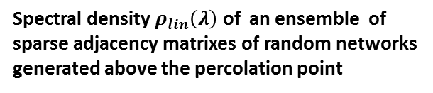
Remark
Models: Ultrametrics of sparse random networks
"Energy landscape" with regularly branching tree of basins.
Spectral density $ρ_{lin}\left(λ\right)$ of an ensemble of sparse adjacency matrixes of random networks generated above the percolation point
Krapivsky P., Nechaev S., and A. V.,
J. Phys. A. 49 (2016), 0335101
Randomly generated sparse sets typically show ultrametricity.

Slide 29
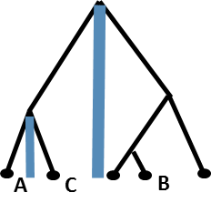
"Basin-to-basin kinetics"
Models: Ultrametric representation of complex landscapes
It is expected that the internal distribution within any basin approaches equilibrium earlier then the system go beyond the basin. In such a case, the transition rates between the basins do not depend on the energy barriers inside the basins. They depend only on the scales of basins and the barriers separated them. In other words, the transition rate is specified by particular branching point, namely by the vertex of a minimal basin in which the transition occurs.
If the transitions are specified by the branching points, then, the triangles of kinetic distances between the states are isosceles or equilateral. This means that the kinetic distances obey the strong triangle inequality, i.e. the space of states is an ultrametric space.
B
A
C
B
A
C

Slide 30
Remark
Models: Ultrametric representation of complex landscapes
Basin-to-basin approximation explicitly suggests an ultrametric space of the states. In this case, the system dynamics cam be modeled by ultrametric random walk.
Simplicity depends here on the simplicity of tree, while complexity is hidden in the ultrametric geometry.

Slide 31
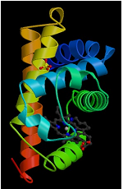
Old question: How does the protein dynamic control the protein functioning?
Models: Protein ultrametricity
Frauenfelder's experiments
Initially, the protein is in a bonded state Mb-CO.
Experiment starts from breaking of the Mb-CO bond by a short laser pulse.
Immediately after the breaking of the bond, myoglobin appears in a stressed state, Mb*, and starts the relaxation to the equilibrated unbound state, Mb.
As fare as unbounded myoglobin reaches the equilibrated state, it becomes active and can anew bind CO.
The idea is that slow conformational dynamics can limit the rebinding kinetics, so, the rebinding kinetics may say somewhat about protein dynamics and protein energy landscape.
stressed
state
Mb*
relaxation of unbounded protein to the equilibrated state
equilibrated state
Mb
CO
Mb
CO-rebinding
Mb-CO
Mb-CO
hν
CO
myoglobin

Slide 32
Model of Frauenfelder's experiment
32/35
Models: Protein ultrametricity
Model of CO-rebinding
Mb*
Initial distribution after the laser pulse
Let X be a space of states of an unbounded protein, and f(x,t), x∈X, is the probability density to find an unbounded protein in state x at the instant t just after the laser pulse. One can subject f(x,t) to the muster equation with simple interpretation. After the laser pulse, unbound proteins are looking for specific binding area, ϕ(x) at which it can bind CO, and, as far as they find this area, they bind CO with some reaction rate.
chemically active states
Mb
Space of states of unbounded protein
X
reaction sink
Conformational dynamics
Reaction sink
Operator D is a key ingredient of the model.

Slide 33
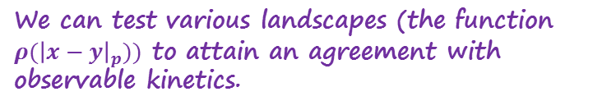
Model related to tree-like approximation of protein energy landscape
Models: Protein ultrametricity
Mb*
distribution right after the laser pulse
active states
Mb
Space of states of unbound proteins
X
reaction sink
Conformational dynamics is modeled by ultrametric random walk.
Reaction-diffusion equation
We can test various landscapes (the function $ρ({\left|x−y\right|}_{p}))$ to attain an agreement with observable kinetics.

Slide 34
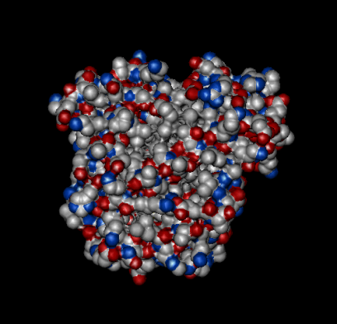
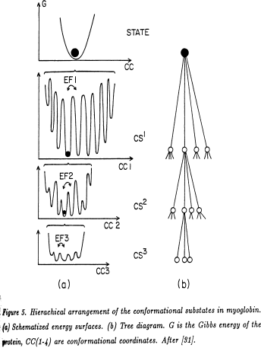
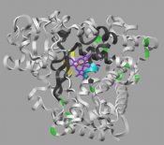
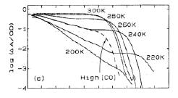
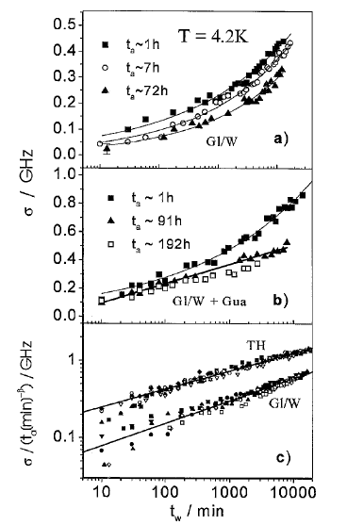
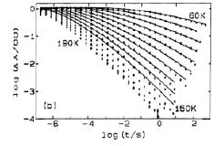
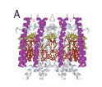
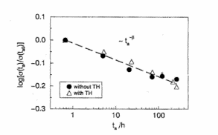
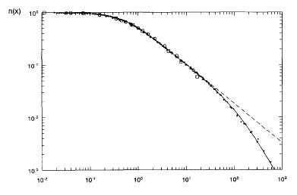
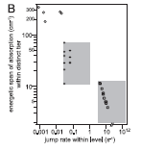
In different experiments, the protein dynamics looks as a random walk in homogeneous ultrametric space
Models: Protein ultrametricity
One and the same ultrametric random walk models protein dynamics in different experiments
CO-rebinding (Hans Frauenfelder, USA)
Spectral diffusion (Josef Friedrich, Germany)
spectral diffusion - single protein studies (Jürgen Köhler, Germany)
It is not clear how to reduce ultrametricity from microscopic level, nevertheless …
For a review on ultrametric modeling of protein dynamics see
V. A., A Kh. Bikulov, A. P. Zubarev. Ultrametric Random Walk and Dynamics of Protein Molecules. Proceedings of the Steklov Institute of Mathematics, 2014, v.285, pp. 3-25.

Slide 35
Concluding remark
Ultrametric looks almost obvious for the sets generated by branching processes in a high-dimensional Euclidean spaces.
Ultrametric looks almost obvious in means of approximation of a complex landscape by a hierarchy of basins.
Ultrametric looks rather mysterious for an ensemble of sparse random networks, which in fact is "a solution of oligomers" with no visible hierarchy.
Thank you.

