Slide 1



Intermittency and non-ergodicity, Two aspects of single-particle trajectories
Yann Lanoiselée and Denis Grebenkov
CNRS - Ecole Polytechnique, France
Interdisciplinary Scientific Center Poncelet, Russia

Slide 2
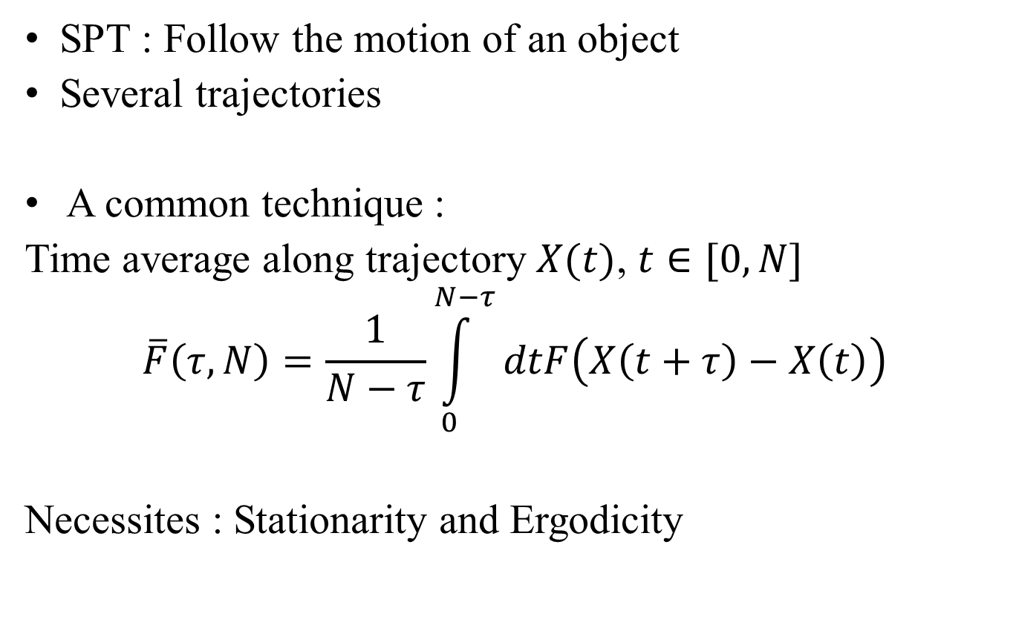
Physical properties from SPT
SPT : Follow the motion of an object
Several trajectories
A common technique :
Time average along trajectory $X(t)$, $t∈[0,N]$
$$\overline{F}\left(τ,N\right)=\frac{1}{N−τ}\int_{0}^{N−τ}{dtF\left(X\left(t+τ\right)−X\left(t\right)\right)}$$
Necessites : Stationarity and Ergodicity

Slide 3
Outline
Reveal Nonergodic features from a single trajectory
Distinguish phases in intermittent motion

Slide 4
Testing nonergodicity from a single trajectory

Slide 5
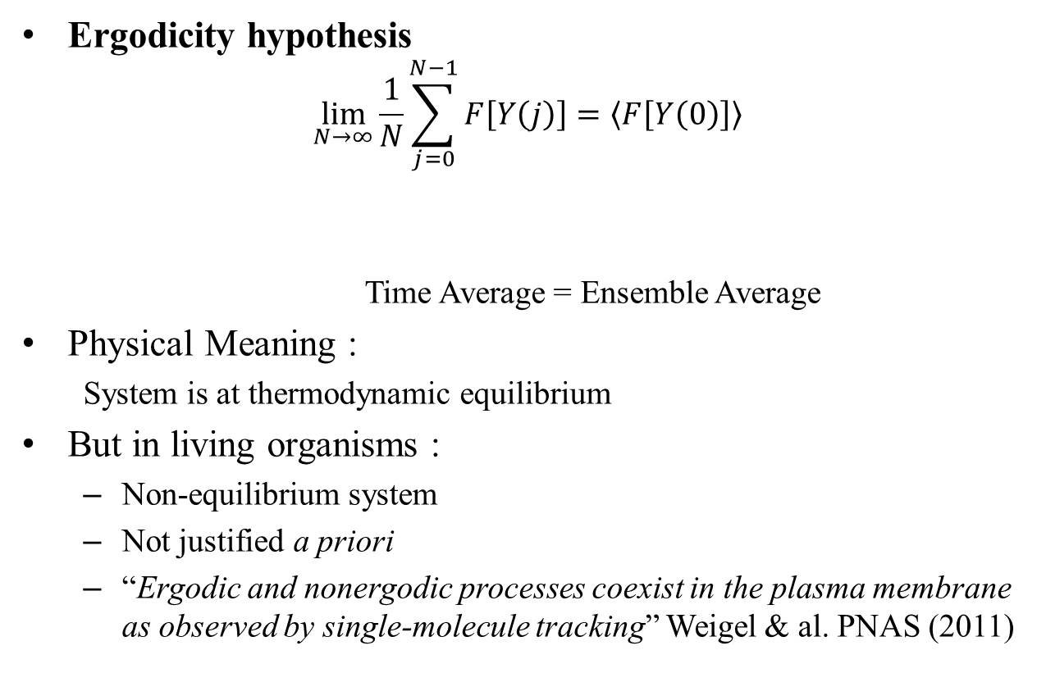
Interpret SPT experiments ?
Ergodicity hypothesis
$$\lim_{N→∞}{\frac{1}{N}\sum_{j=0}^{N−1}{F\left[Y\left(j\right)\right]}}=〈F\left[Y\left(0\right)\right]〉$$
  Time Average = Ensemble Average
Physical Meaning :
  System is at thermodynamic equilibrium
But in living organisms :
  Non-equilibrium system
  Not justified a priori
  “Ergodic and nonergodic processes coexist in the plasma membrane as observed by single-molecule tracking” Weigel & al. PNAS (2011)

Slide 6
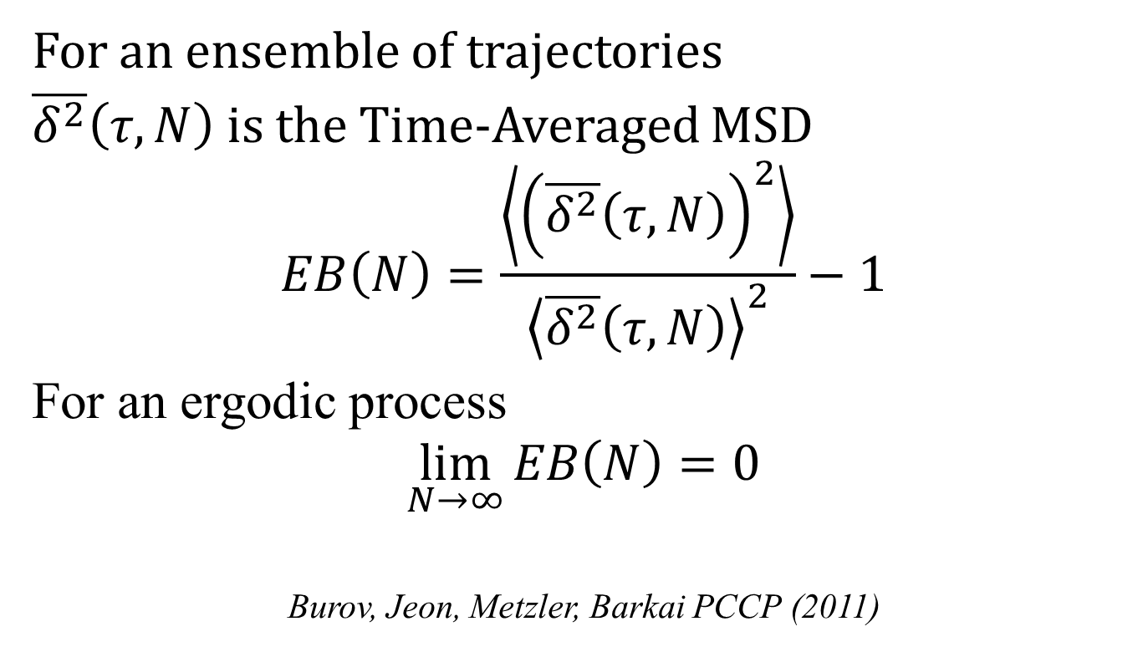
Ergodicity Breaking Parameter
For an ensemble of trajectories
$\overline{δ^{2}}\left(τ,N\right)$ is the Time-Averaged MSD
$$EB\left(N\right)=\frac{\left\langle {\left(\overline{δ^{2}}\left(τ,N\right)\right)}^{2}\right\rangle }{{\left\langle \overline{δ^{2}}\left(τ,N\right)\right\rangle }^{2}}−1$$
For an ergodic process
$$\lim_{N→∞}{EB\left(N\right)=0}$$
Burov, Jeon, Metzler, Barkai PCCP (2011)

Slide 7
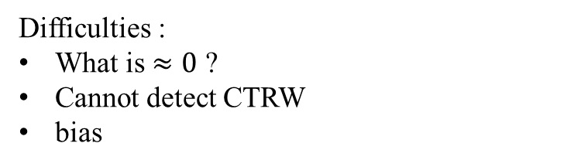
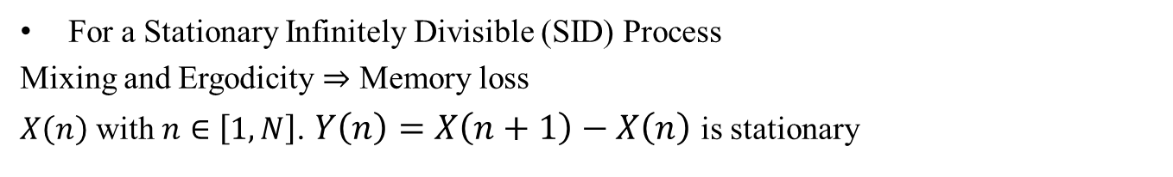
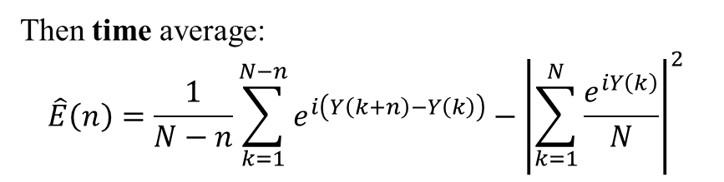
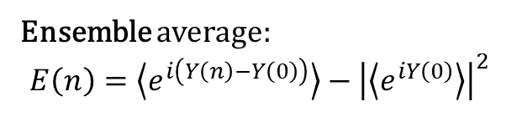
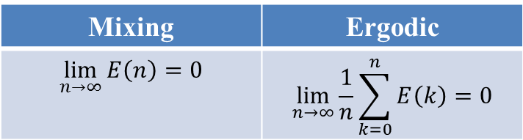
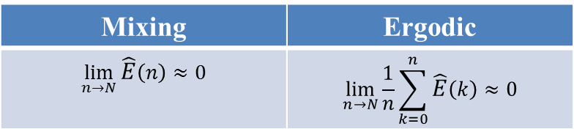
Dynamical Functional
Magdziarz and Weron PRE (2011)
For a Stationary Infinitely Divisible (SID) Process
Mixing and Ergodicity $⇒$ Memory loss
$X\left(n\right)$ with $n∈\left[1,N\right]$. $Y\left(n\right)=X\left(n+1\right)−X\left(n\right)$ is stationary
Ensemble average:
$$E\left(n\right)=\left\langle e^{i\left(Y\left(n\right)−Y\left(0\right)\right)}\right\rangle −{\left|\left\langle e^{iY\left(0\right)}\right\rangle \right|}^{2}$$
Mixing | Ergodic
$$\lim_{n→∞}{E\left(n\right)}=0$$ | $$\lim_{n→∞}{\frac{1}{n}\sum_{k=0}^{n}{E\left(k\right)}}=0$$
Then time average:
$$\hat{E}\left(n\right)=\frac{1}{N−n}\sum_{k=1}^{N−n}{e^{i\left(Y\left(k+n\right)−Y\left(k\right)\right)}}−{\left|\sum_{k=1}^{N}{\frac{e^{iY\left(k\right)}}{N}}\right|}^{2}$$
Difficulties :
What is $≈0$ ?
Cannot detect CTRW
bias
Mixing | Ergodic
$$\lim_{n→N}{\hat{E}\left(n\right)}≈0$$ | $$\lim_{n→N}{\frac{1}{n}\sum_{k=0}^{n}{\hat{E}\left(k\right)}}≈0$$
For finite size :

Slide 8
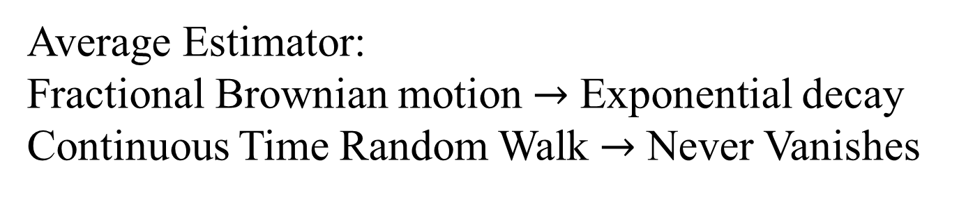
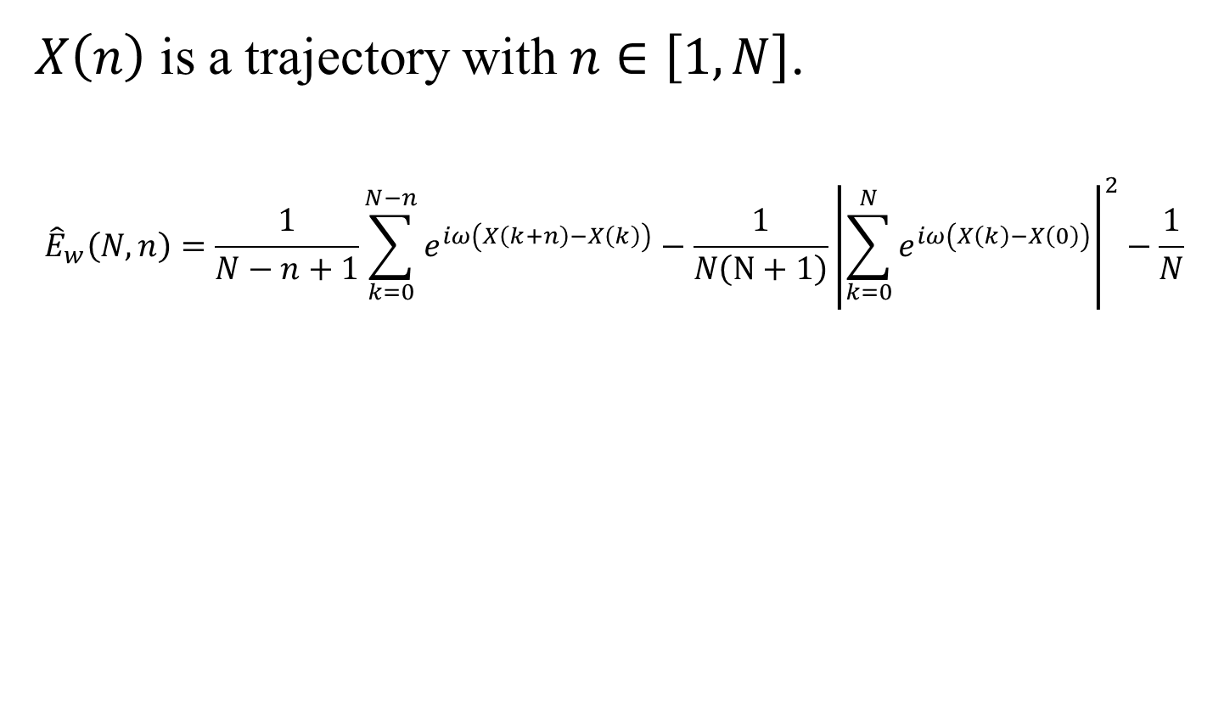
Modified Estimator
$X\left(n\right)$ is a trajectory with $n∈\left[1,N\right]$.
$${\hat{E}}_{w}\left(N,n\right)=\frac{1}{N−n+1}\sum_{k=0}^{N−n}{e^{iω\left(X\left(k+n\right)−X\left(k\right)\right)}}−\frac{1}{N\left(N+1\right)}{\left|\sum_{k=0}^{N}{e^{iω\left(X\left(k\right)−X\left(0\right)\right)}}\right|}^{2}−\frac{1}{N}$$
All fourier modes
Long-time increments
Remove bias
Average Estimator:
Fractional Brownian motion $→$ Exponential decay
Continuous Time Random Walk $→$ Never Vanishes

Slide 9
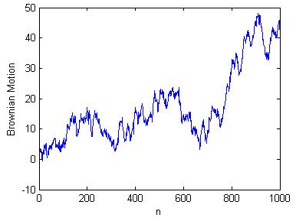
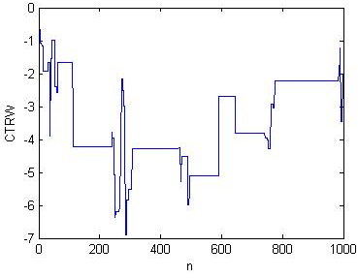
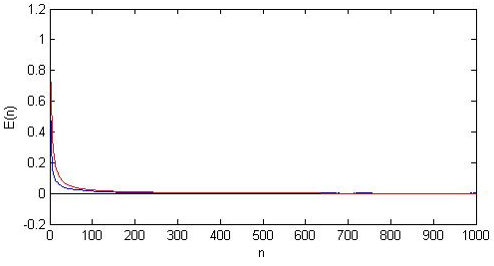
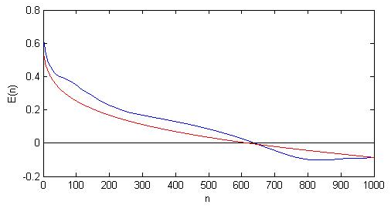
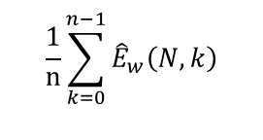
Results
Brownian Motion CTRW
$$\frac{1}{n}\sum_{k=0}^{n−1}{{\hat{E}}_{w}\left(N,k\right)}$$
Ergodic Not Ergodic

Slide 10
Test on experimental data
One Trajectory
mRNA protein in E. Coli Golding and Cox PRL (2006)
Kv2.1 Potassium channel in plasma membrane Weigel et al. PNAS (2011)

Slide 11
Short Conclusion
Progress in the direction to test non-ergodicity from a single trajectory (with statistical uncertainty)
Able to detect CTRW
Statistics of the estimator for some models
Y. Lanoiselée D. Grebenkov Phys. Rev. E 93, 052146 (2016)

Slide 12
What happens for non-stationary processes ?

Slide 13
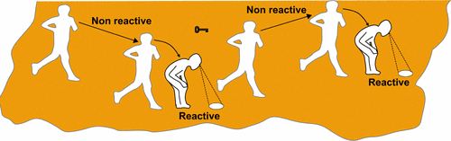
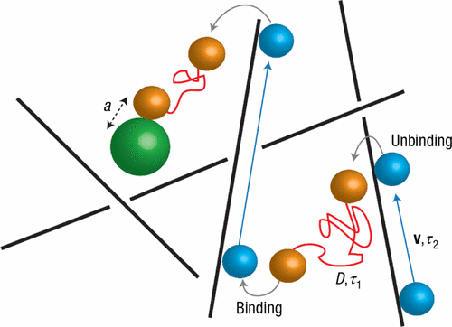

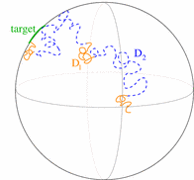
Intermittent Examples
Animal foraging
Active/passive transport in cells
DNA protein interaction
Surface Mediated Diffusion
Bénichou et al. Rev. Mod. Phys. , 83(1), 81 (2011)

Slide 14
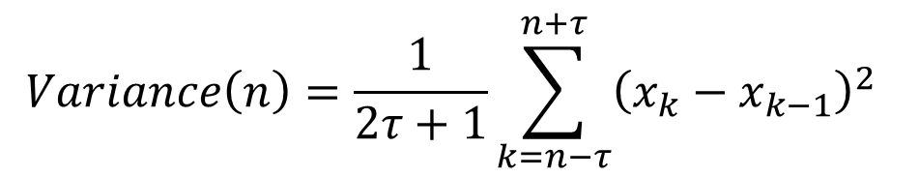
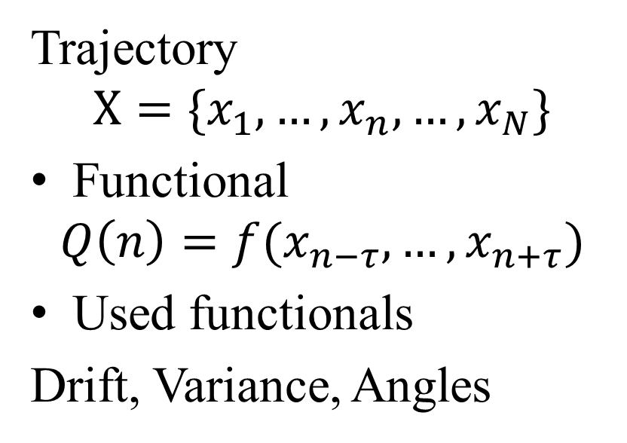
What has been done for intermittent processes
Trajectory
$$X=\{x_{1},…,x_{n},…,x_{N}\}$$
Functional
$$Q\left(n\right)=f(x_{n−τ},…,x_{n+τ})$$
Used functionals
Drift, Variance, Angles
Brownian with 2 Diffusion coef
$$Variance\left(n\right)=\frac{1}{2τ+1}\sum_{k=n−τ}^{n+τ}{{\left(x_{k}−x_{k−1}\right)}^{2}}$$
Variance Functional

Slide 15
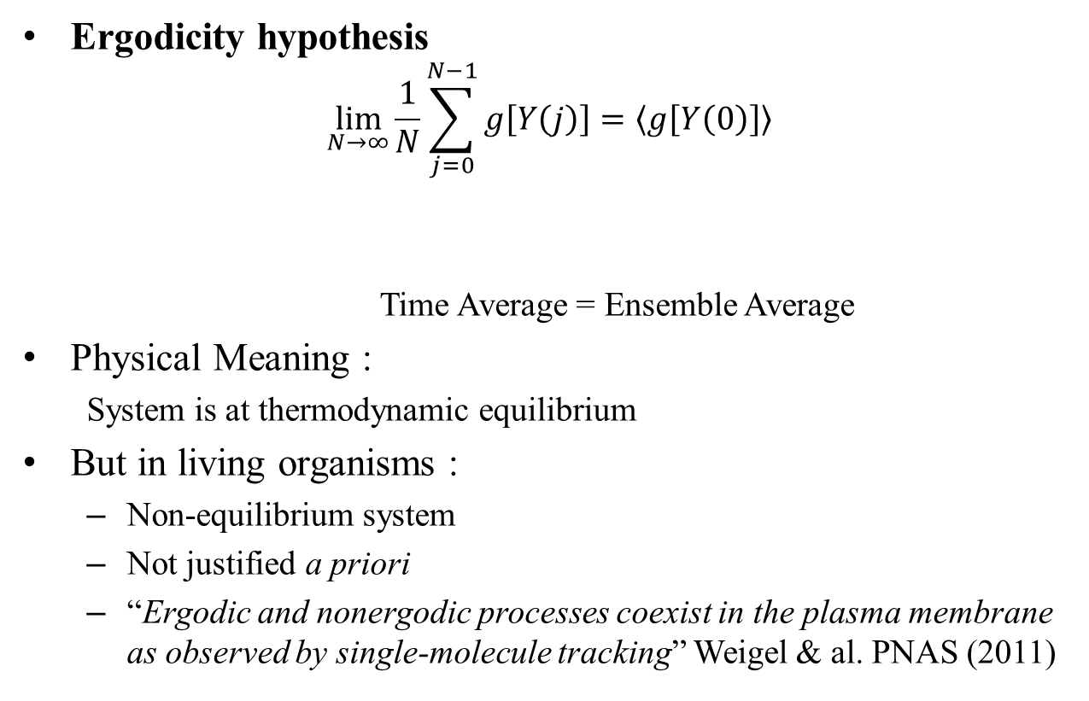
A general question
« Distinguish phases from a binary dynamic ? »
Change phase => Change one property
Should be:
Model free
Robust to noise
Simple to use
Diffusivity Drift Autocorrelation of increments | Isotropic/Anisotropic Distribution of increments Dimensionality Free $≠$ Trapping

Slide 16
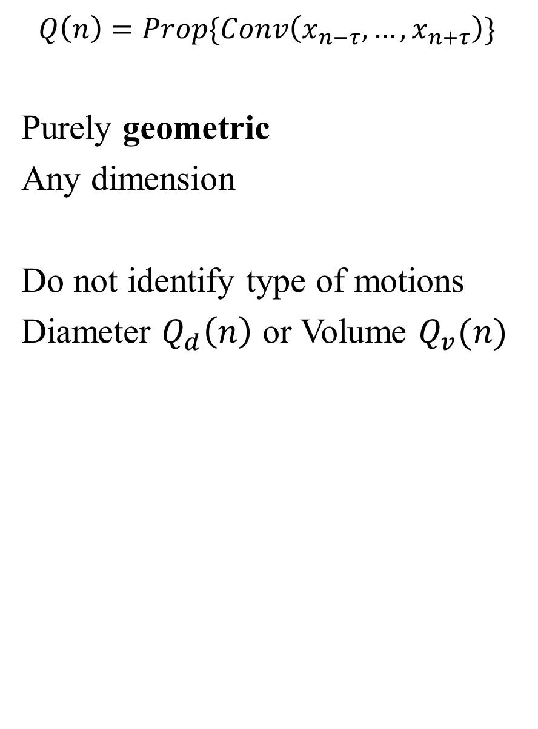
The Local Convex Hull
$$Q\left(n\right)=Prop\{Conv\left(x_{n−τ},…,x_{n+τ}\right)\}$$
Purely geometric
Any dimension
Do not identify type of motions
Diameter $Q_{d}\left(n\right)$ or Volume $Q_{v}(n)$
Intermittent harmonic trapping

Slide 17
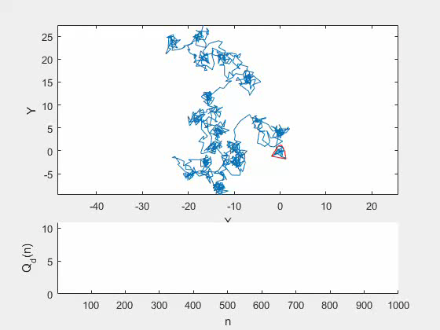

Slide 18
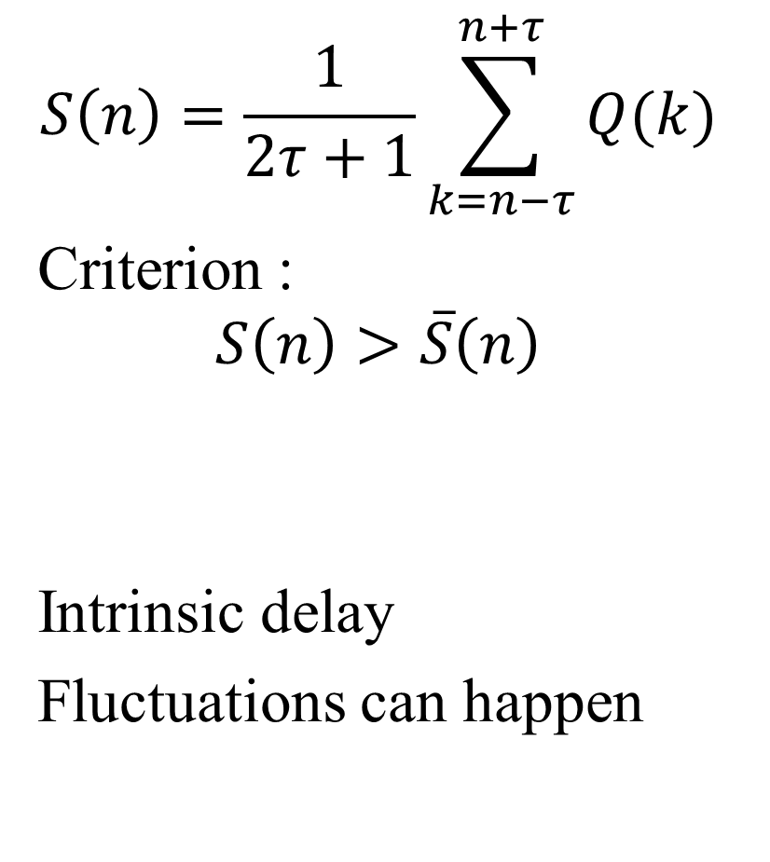

Local Convex Hull Method
$$S\left(n\right)=\frac{1}{2τ+1}\sum_{k=n−τ}^{n+τ}{Q(k)}$$
Criterion :
$$S\left(n\right)>\overline{S}\left(n\right)$$
Intrinsic delay
Fluctuations can happen
2 Brownian motions $D_{1}=\frac{1}{4}$ ; $D_{2}=1$; T=100

Slide 19

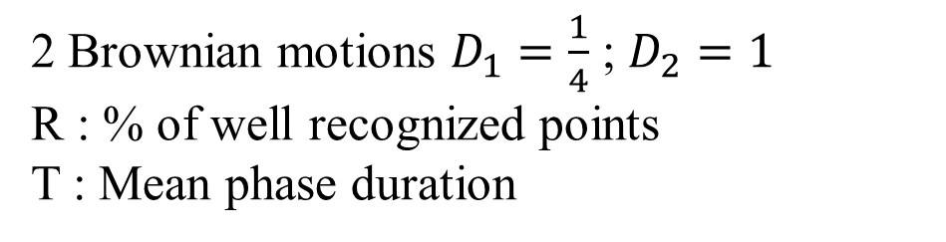
Comparison with Variance
2 Brownian motions $D_{1}=\frac{1}{4}$ ; $D_{2}=1$
R : % of well recognized points
T : Mean phase duration
Convex Hull Diameter
Variance Estimator
In perfect condition variance is better
In noisy conditions local Convex Hull is better

Slide 20
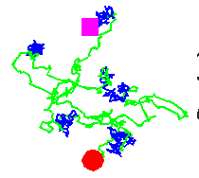
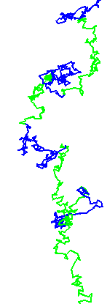
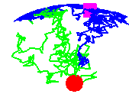
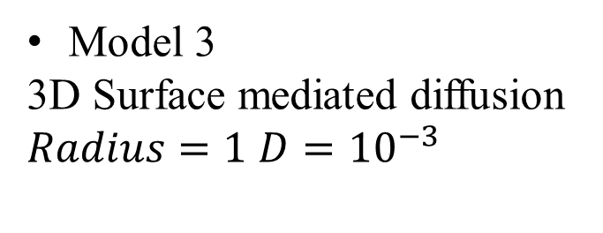
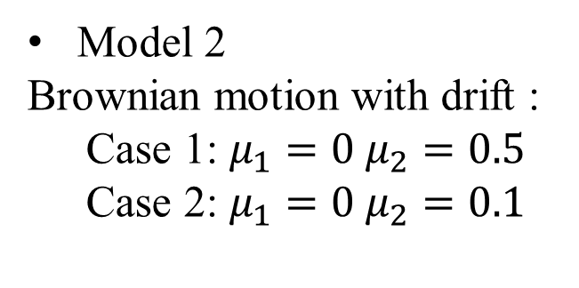
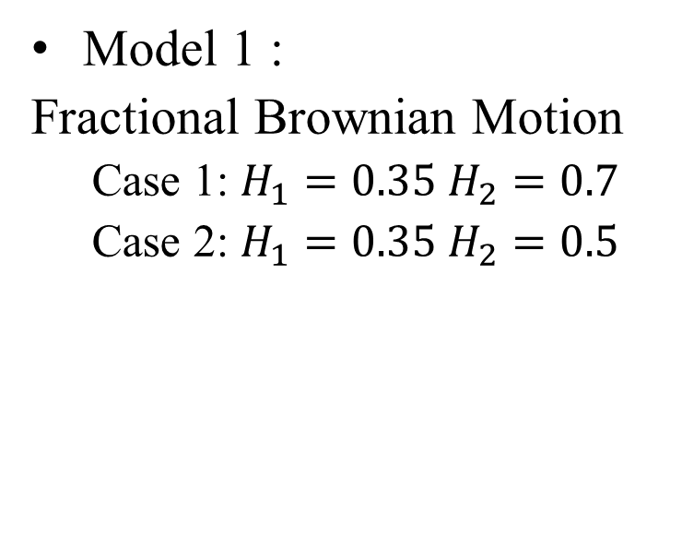
Results
Model 1 :
Fractional Brownian Motion
  Case 1: $H_{1}=0.35 H_{2}=0.7$
  Case 2: $H_{1}=0.35 H_{2}=0.5$
Model 2
Brownian motion with drift :
  Case 1: $μ_{1}=0 μ_{2}=0.5$
  Case 2: $μ_{1}=0 μ_{2}=0.1$
Model 3
3D Surface mediated diffusion
$Radius=1$ $D={10}^{−3}$

Slide 21
Conclusion
Geometric properties => model free recognition
Robust to noise
Wide range of application
Y. Lanoiselée, D. S. Grebenkov Phys. Rev. E 96, 022144 (2017)

Slide 22
Thank you for attention
Articles:
“Revealing nonergodic dynamics in living cells from a single particle trajectory”,
Y. Lanoiselée D. Grebenkov
Phys. Rev. E 93, 052146 (2016)
“Unravelling intermittent features in single particle trajectories by a local convex hull method”
Y. Lanoiselée, D. S. Grebenkov
Phys. Rev. E 96, 022144 (2017)

Slide 23
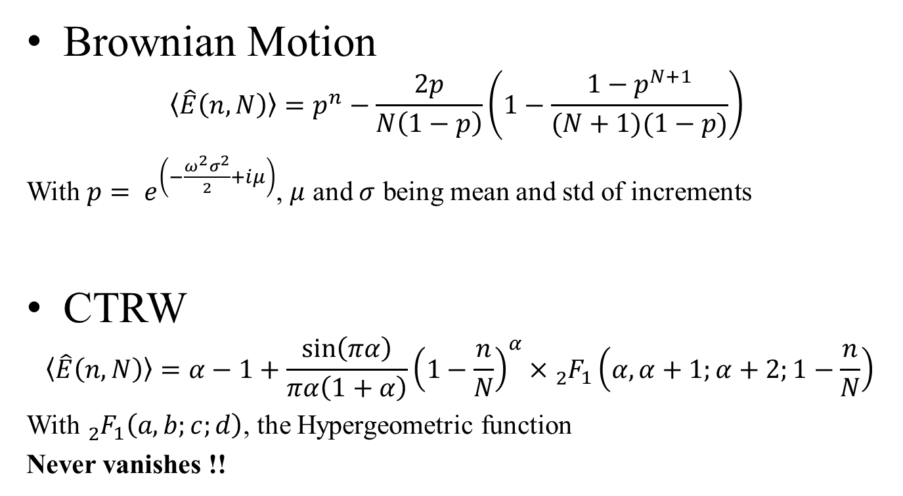
Average estimator
Brownian Motion
$$〈\hat{E}\left(n,N\right)〉=p^{n}−\frac{2p}{N\left(1−p\right)}\left(1−\frac{1−p^{N+1}}{(N+1)(1−p)}\right)$$
With $p= e^{\left(−\frac{ω^{2}σ^{2}}{2}+iμ\right)}$, $μ$ and $σ$ being mean and std of increments
CTRW
$$〈\hat{E}\left(n,N\right)〉=α−1+\frac{\sin\left(πα\right)}{πα\left(1+α\right)}{\left(1−\frac{n}{N}\right)}^{α}×{}_{2}^{}{F_{1}}\left(α,α+1;α+2;1−\frac{n}{N}\right)$$
With ${}_{2}^{}{F_{1}}\left(a,b;c;d\right)$, the Hypergeometric function
Never vanishes !!

Slide 24

Effect of noise
$\tilde{X}\left(n\right)=X\left(n\right)+ξ_{n}$ with $\left\langle ξ_{n}^{2}\right\rangle =σ_{n}^{2}$
$〈\hat{E}\left(n,N\right)〉=〈\hat{E}\left(n,N\right)〉e^{−ω^{2}σ_{n}^{2}}$

