Slide 1
Memory-dependent action for fractal Brownian motion and application for chromatin dynamics
Kirill Polovnikov
Physics Department, Moscow State University
Center for Energy Systems, Skoltech
Saint-Petersburg 2017

Slide 2
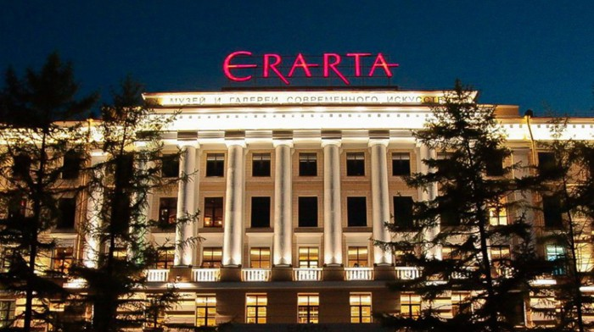
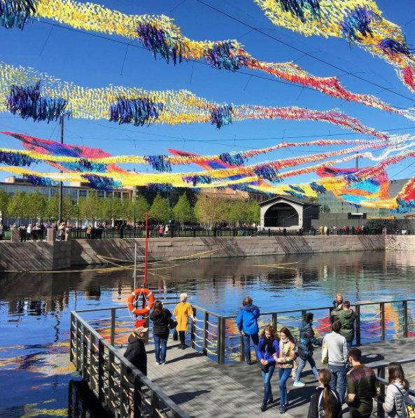
ERARTA MoMA
Bars & tusa
Belinskogo str.
New Holland Island
Park, old industry

Slide 3
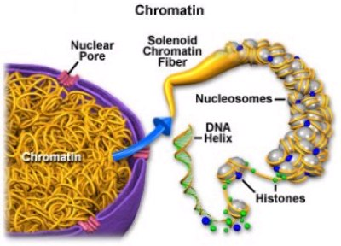

Slide 4
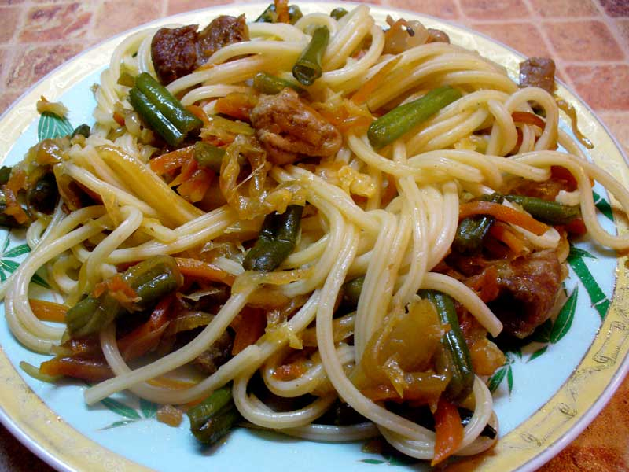
Chromatin dynamics: chain folding and surrounding media contribute jointly

Slide 5
Two limiting cases of chromatin folding
FISH, Hi-C, biology
Fractal globule
$$d_{f}=3$$
$$\left\langle {\left(R_{n}−R_{m}\right)}^{2}\right\rangle ∼{\left|n−m\right|}^{2/d_{f}}$$
Equilibrium globule
$$d_{f}=2$$

Slide 6
Two limiting cases of chromatin folding
FISH, Hi-C, biology
Fractal globule
$$d_{f}=3$$
$$t≪τ_{1}$$
The matter of relaxation times
$$\left\langle {\left(R_{n}−R_{m}\right)}^{2}\right\rangle ∼{\left|n−m\right|}^{2/d_{f}}$$
$$t∼τ_{1}$$
Equilibrium globule
$$d_{f}=2$$

Slide 7
Two limiting cases of chromatin folding
FISH, Hi-C, biology
Fractal globule
$$d_{f}=3$$
$$t≪τ_{1}$$
The matter of relaxation times
$$\left\langle {\left(R_{n}−R_{m}\right)}^{2}\right\rangle ∼{\left|n−m\right|}^{2/d_{f}}$$
$$t∼τ_{1}$$
Equilibrium globule
$$d_{f}=2$$

Slide 8
Two limiting cases of chromatin folding
FISH, Hi-C, biology
Fractal globule
$$d_{f}=3$$
$$t≪τ_{1}$$
The matter of relaxation times
$$\left\langle {\left(R_{n}−R_{m}\right)}^{2}\right\rangle ∼{\left|n−m\right|}^{2/d_{f}}$$
$$t∼τ_{1}$$
Equilibrium globule
$$d_{f}=2$$
$τ_{1}∼N^{3}∼500$ years >> cell lifetime!

Slide 9
Two limiting cases of chromatin folding
FISH, Hi-C, biology
Fractal globule
$$d_{f}=3$$
$$t≪τ_{1}$$
The matter of relaxation times
$$\left\langle {\left(R_{n}−R_{m}\right)}^{2}\right\rangle ∼{\left|n−m\right|}^{2/d_{f}}$$
$$t∼τ_{1}$$
Equilibrium globule
$$d_{f}=2$$
$τ_{1}∼N^{3}∼500$ years >> cell lifetime!
Chromatin folding is very stable

Slide 10
Two limiting cases of chromatin folding
FISH, Hi-C, biology
Fractal globule
$$d_{f}=3$$
$$t≪τ_{1}$$
The matter of relaxation times
$$\left\langle {\left(R_{n}−R_{m}\right)}^{2}\right\rangle ∼{\left|n−m\right|}^{2/d_{f}}$$
$$t∼τ_{1}$$
Equilibrium globule
$$d_{f}=2$$
$τ_{1}∼N^{3}∼500$ years >> cell lifetime!
Chromatin folding is very stable
+attachment to lamina, binding with CTCF and cohesin

Slide 11
Fractal globule in a heat bath: Gaussian approximation for the conformation
$$\left\langle {\left(R_{n}−R_{m}\right)}^{2}\right\rangle =a^{2}{\left|n−m\right|}^{2/3}$$
$P\left(x_{n},x_{m}, |n−m|\right)= {\frac{1}{|n−m|}\left(\frac{1}{2πa^{2}}\right)}^{3/2}exp\left(−\frac{{\left(x_{n}−x_{m}\right)}^{2}}{2a^{2}{\left|n−m\right|}^{2/3}}\right)$;
$$P_{cont}\left(\left|n−m\right|\right)∼\frac{1}{|n−m|}$$
Hi-C

Slide 12
Fractal globule in a heat bath: Gaussian approximation for the conformation
$$\left\langle {\left(R_{n}−R_{m}\right)}^{2}\right\rangle =a^{2}{\left|n−m\right|}^{2/3}$$
$P\left(x_{n},x_{m}, |n−m|\right)= {\frac{1}{|n−m|}\left(\frac{1}{2πa^{2}}\right)}^{3/2}exp\left(−\frac{{\left(x_{n}−x_{m}\right)}^{2}}{2a^{2}{\left|n−m\right|}^{2/3}}\right)$;
$$P_{cont}\left(\left|n−m\right|\right)∼\frac{1}{|n−m|}$$
Hi-C
Telomere dynamics in the nucleus of vivo human cells
is Gaussian (K. Burnecki et al, BJ 2012)

Slide 13
Fractal globule in a heat bath: Gaussian approximation for the conformation
$$\left\langle {\left(R_{n}−R_{m}\right)}^{2}\right\rangle =a^{2}{\left|n−m\right|}^{2/3}$$
$P\left(x_{n},x_{m}, |n−m|\right)= {\frac{1}{|n−m|}\left(\frac{1}{2πa^{2}}\right)}^{3/2}exp\left(−\frac{{\left(x_{n}−x_{m}\right)}^{2}}{2a^{2}{\left|n−m\right|}^{2/3}}\right)$;
$$P_{cont}\left(\left|n−m\right|\right)∼\frac{1}{|n−m|}$$
Hi-C
Telomere dynamics in the nucleus of vivo human cells
is Gaussian (K. Burnecki et al, BJ 2012)
fractal globule is a trajectory of fBm particle with H = 2/3

Slide 14
Fractal globule in a heat bath: Gaussian approximation for the conformation
$$\left\langle {\left(R_{n}−R_{m}\right)}^{2}\right\rangle =a^{2}{\left|n−m\right|}^{2/3}$$
$P\left(x_{n},x_{m}, |n−m|\right)= {\frac{1}{|n−m|}\left(\frac{1}{2πa^{2}}\right)}^{3/2}exp\left(−\frac{{\left(x_{n}−x_{m}\right)}^{2}}{2a^{2}{\left|n−m\right|}^{2/3}}\right)$;
$$P_{cont}\left(\left|n−m\right|\right)∼\frac{1}{|n−m|}$$
Hi-C
Telomere dynamics in the nucleus of vivo human cells
is Gaussian (K. Burnecki et al, BJ 2012)
fractal globule is a trajectory of fBm particle with H = 2/3
What interactions do stabilize fBm conformation?

Slide 15
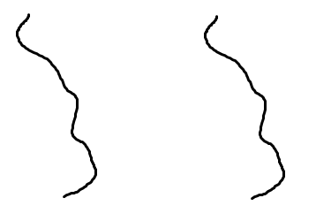
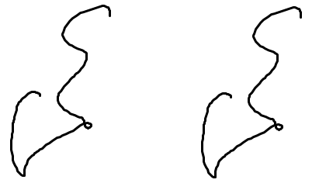
Trace of a particle = conformation of a polymer chain
BM
Ideal polymer chain
FBM
?
$$t$$
$$x_{n}$$
$$x_{n}$$
$$B_{H}(t)$$
$$t$$
$$j$$
$$i$$
$$B(t)$$
$$φ\left(x_{0},x_{1}, …, x_{N}\right)=\frac{k}{2}\sum_{i=1}^{N}{{\left(x_{i}−x_{i−1}\right)}^{2}}$$
$$φ\left(x_{0},x_{1}, …, x_{N}\right)=\sum_{i,j}{φ_{ij}(x_{i}, x_{j})}$$

Slide 16
Trace of a particle = conformation of a polymer chain
BM
Ideal polymer chain
FBM
?
$$t$$
$$x_{n}$$
$$x_{n}$$
$$B_{H}(t)$$
$$t$$
$$j$$
$$i$$
$$B(t)$$
$$φ\left(x_{0},x_{1}, …, x_{N}\right)=\frac{k}{2}\sum_{i=1}^{N}{{\left(x_{i}−x_{i−1}\right)}^{2}}$$
$$φ\left(x_{0},x_{1}, …, x_{N}\right)=\sum_{i,j}{φ_{ij}(x_{i}, x_{j})}$$
?

Slide 17
What the fractal Brownian motion is?
FBM can be defined through the Weyl integral as follows
($0<H<1$ is the Hurst parameter):
$$B_{H}\left(t_{2}\right)−B_{H}\left(t_{1}\right)= \frac{1}{Γ\left(H+\frac{1}{2}\right)} \left[\int_{−∞}^{t_{2}}{{\left(t_{2}−s\right)}^{H−\frac{1}{2}}dB\left(s\right)−}\int_{−∞}^{t_{1}}{{\left(t_{1}−s\right)}^{H−\frac{1}{2}}dB(s)}\right]$$
It is the only Gaussian self-similar process with stationary increments
$P\left(B_{1},B_{2}, τ\right)= {\left(\frac{1}{2πD_{H}{|t_{1}−t_{2}|}^{2H}}\right)}^{d/2}exp\left(−\frac{{\left(B_{1}−B_{2}\right)}^{2}}{2D_{H}{|t_{1}−t_{2}|}^{2H}}\right)$;
$$\left\langle {\left(B_{H}\left(t_{2}\right)−B_{H}\left(t_{1}\right)\right)}^{2}\right\rangle =D_{H}{\left|t_{2}−t_{1}\right|}^{2H}$$
FBM is solution of fractal Langevin equation with pink Gaussian noise:
$$\frac{dB_{H}}{dt}=F_{H}$$
$$\left\langle F_{H}\left(t_{1}\right)F_{H}(t_{2})\right\rangle =D_{H}{\left|t_{2}−t_{1}\right|}^{2H−2}$$
doesn’t satisfy fluctuation-dissipation theorem!

Slide 18
What the fractal Brownian motion is?
FBM can be defined through the Weyl integral as follows
($0<H<1$ is the Hurst parameter):
$$B_{H}\left(t_{2}\right)−B_{H}\left(t_{1}\right)= \frac{1}{Γ\left(H+\frac{1}{2}\right)} \left[\int_{−∞}^{t_{2}}{{\left(t_{2}−s\right)}^{H−\frac{1}{2}}dB\left(s\right)−}\int_{−∞}^{t_{1}}{{\left(t_{1}−s\right)}^{H−\frac{1}{2}}dB(s)}\right]$$
It is the only Gaussian self-similar process with stationary increments
$P\left(B_{1},B_{2}, τ\right)= {\left(\frac{1}{2πD_{H}{|t_{1}−t_{2}|}^{2H}}\right)}^{d/2}exp\left(−\frac{{\left(B_{1}−B_{2}\right)}^{2}}{2D_{H}{|t_{1}−t_{2}|}^{2H}}\right)$;
$$\left\langle {\left(B_{H}\left(t_{2}\right)−B_{H}\left(t_{1}\right)\right)}^{2}\right\rangle =D_{H}{\left|t_{2}−t_{1}\right|}^{2H}$$
FBM is large-time solution of fractional Langevin equation with pink G.n., $0<α<1$:
$$\int_{0}^{t}{dτ K_{α}(t−τ)\frac{dX(τ)}{dτ}}=F_{α}(t)$$
$$K\left(t\right)=D_{α}\frac{(2−α)(1−α)}{t^{α}}$$
$$\left\langle F_{α}\left(t_{1}\right)F_{α}(t_{2})\right\rangle =K_{α}(t_{1}−t_{2})$$

Slide 19
What the fractal Brownian motion is?
FBM can be defined through the Weyl integral as follows
($0<H<1$ is the Hurst parameter):
$$B_{H}\left(t_{2}\right)−B_{H}\left(t_{1}\right)= \frac{1}{Γ\left(H+\frac{1}{2}\right)} \left[\int_{−∞}^{t_{2}}{{\left(t_{2}−s\right)}^{H−\frac{1}{2}}dB\left(s\right)−}\int_{−∞}^{t_{1}}{{\left(t_{1}−s\right)}^{H−\frac{1}{2}}dB(s)}\right]$$
It is the only Gaussian self-similar process with stationary increments
$P\left(B_{1},B_{2}, τ\right)= {\left(\frac{1}{2πD_{H}{|t_{1}−t_{2}|}^{2H}}\right)}^{d/2}exp\left(−\frac{{\left(B_{1}−B_{2}\right)}^{2}}{2D_{H}{|t_{1}−t_{2}|}^{2H}}\right)$;
$$\left\langle {\left(B_{H}\left(t_{2}\right)−B_{H}\left(t_{1}\right)\right)}^{2}\right\rangle =D_{H}{\left|t_{2}−t_{1}\right|}^{2H}$$
FBM is large-time solution of fractional Langevin equation with pink G.n., $0<α<1$:
$$\int_{0}^{t}{dτ K_{α}(t−τ)\frac{dX(τ)}{dτ}}=F_{α}(t)$$
$$K\left(t\right)=D_{α}\frac{(2−α)(1−α)}{t^{α}}$$
$$\left\langle F_{α}\left(t_{1}\right)F_{α}(t_{2})\right\rangle =K_{α}(t_{1}−t_{2})$$
$$\left\langle X^{2}(t)\right\rangle {\left.​\right|}_{t≫1}∼t^{α}$$
$$α=2H$$

Slide 20
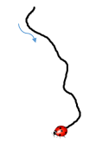
Action of the Brownian particle from ideal polymer chain model
$$P_{N}\left(x_{0},x_{N}\right)=\int{\prod_{j=1}^{N−1}{dx_{j}}\prod_{j=0}^{N−1}{g(x_{j+1}−x_{j})}}$$
$$g\left(x\right)= {\left(\frac{d}{2πa^{2}}\right)}^{d/2}exp\left(−\frac{dx^{2}}{2a^{2}}\right)$$
$$t$$
$$X(t)$$

Slide 21
Action of the Brownian particle from ideal polymer chain model
$$P_{N}\left(x_{0},x_{N}\right)=\int{\prod_{j=1}^{N−1}{dx_{j}}\prod_{j=0}^{N−1}{g(x_{j+1}−x_{j})}}$$
$$g\left(x\right)= {\left(\frac{d}{2πa^{2}}\right)}^{d/2}exp\left(−\frac{dx^{2}}{2a^{2}}\right)$$
In the limit $N→∞, a→0, L=aN=const$, d.f. can be rewritten as a path integral:
$$P\left(x_{0},x, N\right)=\int{D\left\{X\right\} exp⁡(−S)}$$
$$X\left(0\right)=x_{0}; X\left(N\right)=x$$
$$t$$
$$S=\int_{0}^{N}{dt \left[\frac{d}{2a^{2}}{\left(\frac{∂X}{∂t}\right)}^{2}\right]}$$
where
is action of the Brownian particle
$$X(t)$$

Slide 22
Action of the Brownian particle from ideal polymer chain model
$$P_{N}\left(x_{0},x_{N}\right)=\int{\prod_{j=1}^{N−1}{dx_{j}}\prod_{j=0}^{N−1}{g(x_{j+1}−x_{j})}\prod_{j=0}^{N}{exp⁡(−u(x_{j}))}}$$
$$g\left(x\right)= {\left(\frac{d}{2πa^{2}}\right)}^{d/2}exp\left(−\frac{dx^{2}}{2a^{2}}\right)$$
In the limit $N→∞, a→0, L=aN=const$, d.f. can be rewritten as a path integral:
$$P\left(x_{0},x, N\right)=\int{D\left\{X\right\} exp⁡(−S)}$$
$$X\left(0\right)=x_{0}; X\left(N\right)=x$$
$$t$$
$$S=\int_{0}^{N}{dt \left[\frac{d}{2a^{2}}{\left(\frac{∂X}{∂t}\right)}^{2}+u(X(t))\right]}$$
where
is action of the Brownian particle
$$X(t)$$

Slide 23
Action of the Brownian particle from ideal polymer chain model
$$P\left(x_{0},x, N\right)=\int{D\left\{X\right\} exp⁡(−S)}$$
$$X\left(0\right)=x_{0}; X\left(N\right)=x$$
$$S=\int_{0}^{N}{dt \left[\frac{d}{2a^{2}}{\left(\frac{∂X}{∂t}\right)}^{2}\right]}$$
where
is action of the Brownian particle
$$t$$
$$X(t)$$

Slide 24
Action of the Brownian particle from ideal polymer chain model
$$P\left(x_{0},x, N\right)=\int{D\left\{X\right\} exp⁡(−S)}$$
$$X\left(0\right)=x_{0}; X\left(N\right)=x$$
$$S=\int_{0}^{N}{dt \left[\frac{d}{2a^{2}}{\left(\frac{∂X}{∂t}\right)}^{2}\right]}$$
where
is action of the Brownian particle
$$\frac{∂P(r, s)}{∂s}=DΔP(r, s)$$
Diffusion equation:
$$s=\left|k−m\right|;$$
$$D=a^{2}/2d$$
$$P\left(x_{k},x_{m}, s\right)= {\left(\frac{d}{2πsa^{2}}\right)}^{d/2}exp\left(−\frac{d{\left(x_{k}−x_{m}\right)}^{2}}{2sa^{2}}\right)$$
$$t$$
$$X(t)$$

Slide 25
Action of the Brownian particle from ideal polymer chain model
$$P\left(x_{0},x, N\right)=\int{D\left\{X\right\} exp⁡(−S)}$$
$$X\left(0\right)=x_{0}; X\left(N\right)=x$$
$$S=\int_{0}^{N}{dt \left[\frac{d}{2a^{2}}{\left(\frac{∂X}{∂t}\right)}^{2}\right]}$$
where
is action of the Brownian particle
$$\frac{∂P(r, s)}{∂s}=DΔP(r, s)$$
Diffusion equation:
$$s=\left|k−m\right|;$$
$$D=a^{2}/2d$$
$$P\left(x_{k},x_{m}, s\right)= {\left(\frac{d}{2πsa^{2}}\right)}^{d/2}exp\left(−\frac{d{\left(x_{k}−x_{m}\right)}^{2}}{2sa^{2}}\right)$$
$$t$$
Reverse problem. We know fBm statistics, how to find action?
$$P\left(x_{k},x_{m}, s\right)= {\left(\frac{1}{2πs^{2H}D_{H}}\right)}^{d/2}exp\left(−\frac{{\left(x_{k}−x_{m}\right)}^{2H}}{2s^{2H}D_{H}}\right)$$
$$X(t)$$

Slide 26
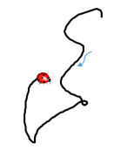
Action of the fractal Brownian particle
Reverse the problem. We know fBm statistics, how to find action?
$$X(t)$$
$$P\left(x_{k},x_{m}, s\right)= {\left(\frac{1}{2πs^{2H}D_{H}}\right)}^{d/2}exp\left(−\frac{{\left(x_{k}−x_{m}\right)}^{2H}}{2s^{2H}D_{H}}\right)$$
$$t$$

Slide 27
Action of the fractal Brownian particle
Reverse the problem. We know fBm statistics, how to find action?
$$X(t)$$
$$P\left(x_{k},x_{m}, s\right)= {\left(\frac{1}{2πs^{2H}D_{H}}\right)}^{d/2}exp\left(−\frac{{\left(x_{k}−x_{m}\right)}^{2H}}{2s^{2H}D_{H}}\right)$$
$$t$$
Oshanin, 1988. The action of a single monomer of the ideal chain (H = 1/4):
$$\left\langle {\left(X\left(t_{1}\right)−X\left(t_{2}\right)\right)}^{2}\right\rangle {\left.​\right|}_{\left|t_{1}−t_{2}\right|≫1}∼{\left|t_{1}−t_{2}\right|}^{1/2}$$
$$S_{1/4}∼\int_{0}^{T}{\int_{0}^{T}{dt dt^{′}\frac{1}{\sqrt{|t−t′|}}\frac{∂X(t)}{∂t}\frac{∂X(t′)}{∂t′}}}$$

Slide 28
Action of the fractal Brownian particle
Reverse the problem. We know fBm statistics, how to find action?
$$X(t)$$
$$P\left(x_{k},x_{m}, s\right)= {\left(\frac{1}{2πs^{2H}D_{H}}\right)}^{d/2}exp\left(−\frac{{\left(x_{k}−x_{m}\right)}^{2H}}{2s^{2H}D_{H}}\right)$$
$$t$$
Oshanin, 1988. The action of a single monomer of the ideal chain (H = 1/4):
$$\left\langle {\left(X\left(t_{1}\right)−X\left(t_{2}\right)\right)}^{2}\right\rangle {\left.​\right|}_{\left|t_{1}−t_{2}\right|≫1}∼{\left|t_{1}−t_{2}\right|}^{1/2}$$
$$S_{1/4}∼\int_{0}^{T}{\int_{0}^{T}{dt dt^{′}\frac{1}{\sqrt{|t−t′|}}\frac{∂X(t)}{∂t}\frac{∂X(t′)}{∂t′}}}$$
The most intuitive generalization:
$$S_{H}=\frac{1}{D_{H}}\int_{0}^{N}{\int_{0}^{N}{dt dt^{′}φ_{H}\left(|t−t′|\right)\frac{∂X(t)}{∂t}\frac{∂X(t′)}{∂t′}}}$$
where $φ_{H}\left(t\right)∼\frac{1}{t^{α(H)}}$
$$α\left(H\right)− ?$$

Slide 29
How to introduce interactions
but stay in the class of Gaussian
conformations?
$$x_{n}$$
$$B_{H}(t)$$
$$t$$
$$j$$
$$i$$
$$φ\left(x_{0},x_{1}, …, x_{N}\right)=\sum_{i,j}{φ_{ij}(x_{i}, x_{j})}$$

Slide 30
How to introduce interactions
but stay in the class of Gaussian
conformations?
$$x_{n}$$
$$B_{H}(t)$$
$$t$$
$$j$$
$$i$$
$$φ\left(x_{0},x_{1}, …, x_{N}\right)=\sum_{i,j}{φ_{ij}(x_{i}, x_{j})}≈\frac{1}{2}\sum_{i<j}{A_{ij}{\left(x_{i}−x_{j}\right)}^{2} }$$

Slide 31
How to introduce interactions
but stay in the class of Gaussian
conformations?
$$x_{n}$$
$$B_{H}(t)$$
$$t$$
$$j$$
$$i$$
$$φ\left(x_{0},x_{1}, …, x_{N}\right)=\sum_{i,j}{φ_{ij}(x_{i}, x_{j})}≈\frac{1}{2}\sum_{i,j}{A_{ij}{\left(x_{i}−x_{j}\right)}^{2}=}$$
$$\frac{1}{2}\sum_{i=0}^{N−1}{A_{i,i+1}}{\left(x_{i+1 }−x_{i}\right)}^{2}+ \frac{1}{2}\sum_{i<j−1}^{N}{A_{ij}{\left(x_{i}−x_{j}\right)}^{2}}$$
linear connectivity
soft volume interactions

Slide 32
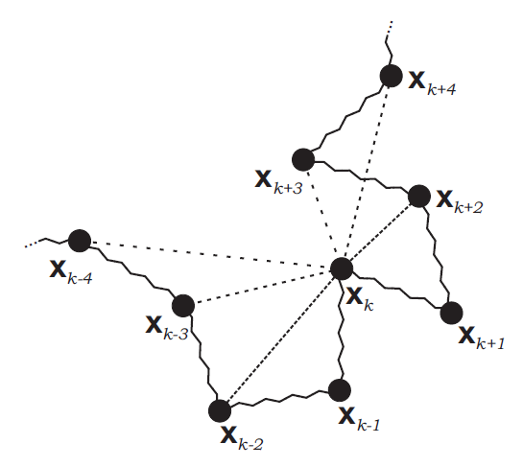
Complete graph of monomers connected by
Gaussian springs of different rigidities
$$φ\left(x_{0},x_{1}, …, x_{N}\right)=\frac{1}{2}\sum_{i,j}{A_{ij}{\left(x_{i}−x_{j}\right)}^{2}}$$
$$P\left(x_{0}, x_{ij}\right)= \frac{\int{dx_{1}dx_{2}..dx_{N}\exp\left(−φ\right)δ\left(x_{ij}−(x_{i}−x_{j})\right)}}{\int{dx_{1}dx_{2}..dx_{N} exp⁡(−φ)}}$$

Slide 33
Complete graph of monomers connected by
Gaussian springs of different rigidities
$$φ\left(x_{0},x_{1}, …, x_{N}\right)=\frac{1}{2}\sum_{i,j}{A_{ij}{\left(x_{i}−x_{j}\right)}^{2}}$$
$$P\left(x_{0}, x_{ij}\right)= \frac{\int{dx_{1}dx_{2}..dx_{N}\exp\left(−φ\right)δ\left(x_{ij}−(x_{i}−x_{j})\right)}}{\int{dx_{1}dx_{2}..dx_{N} exp⁡(−φ)}}$$
In order to obtain for $\left|i−j\right|≫1$, $P\left(x_{i}, x_{j}, \left|i−j\right|\right)$ is Gaussian p.d.f. with dispersion $σ_{ij}^{2}∼{\left|i−j\right|}^{2/d_{f}}$ one should take
$$A_{ij }∼A_{s=\left|i−j\right|}∼\left\{\begin{aligned}\frac{c\left(γ\right)}{s^{γ}} \\ δ_{s0}+δ_{s1} \end{aligned}\right.$$
$$γ∈(2,4)\backslash \{3\}$$
$$γ=3$$
KP, S. Nechaev, M. Tamm, arXiv:1707.07153

Slide 34
Complete graph of monomers connected by
Gaussian springs of different rigidities
$$φ\left(x_{0},x_{1}, …, x_{N}\right)=\frac{1}{2}\sum_{i,j}{A_{ij}{\left(x_{i}−x_{j}\right)}^{2}}$$
$$P\left(x_{0}, x_{ij}\right)= \frac{\int{dx_{1}dx_{2}..dx_{N}\exp\left(−φ\right)δ\left(x_{ij}−(x_{i}−x_{j})\right)}}{\int{dx_{1}dx_{2}..dx_{N} exp⁡(−φ)}}$$
In order to obtain for $\left|i−j\right|≫1$, $P\left(x_{i}, x_{j}, \left|i−j\right|\right)$ is Gaussian p.d.f. with dispersion $σ_{ij}^{2}∼{\left|i−j\right|}^{2/d_{f}}$ one should take
$$γ=2\left(1+ \frac{1}{d_{f}}\right)$$
$$A_{ij }∼A_{s=\left|i−j\right|}∼\left\{\begin{aligned}\frac{c\left(γ\right)}{s^{γ}} \\ δ_{s0}+δ_{s1} \end{aligned}\right.$$
$$γ∈(2,4)\backslash \{3\}$$
$$γ=3$$
Ideal chain corresponds to the $γ=3$
fractal globule to $γ=8/3$
KP, S. Nechaev, M. Tamm, arXiv:1707.07153

Slide 35
$$φ\left(x_{0},x_{1}, …, x_{N}\right)=\frac{1}{2}\sum_{p=0}^{N−1}{λ_{p}u_{p}^{2}}$$
where $λ_{p}$ is spectrum of the Laplacian $B=\left\{b_{ij}\right\}:$
$$b_{ii}=−\sum_{k≠i}{A_{ik}}$$
$b_{ij}=A_{ij}, i≠j$;
For ideal chain $B$is bi-diagonal:
$$λ_{p}=λ_{N}\sin^{2}{\frac{pπ}{2N}}$$
For a Gaussian chain with arbitrary dimension $d_{f}$:
$$λ_{p}=λ_{N}\sin^{β}{\frac{pπ}{2N}}$$
$$β=1+\frac{2}{d_{f}}$$
where
KP, S. Nechaev, M. Tamm, arXiv:1707.07153

Slide 36
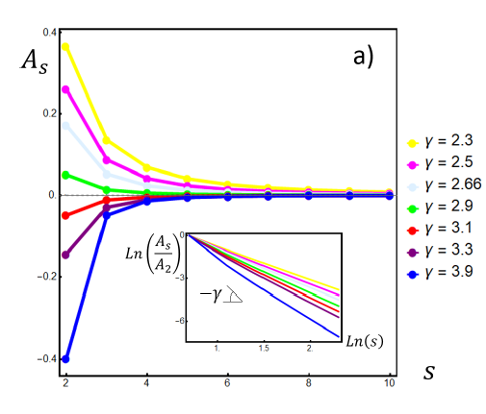
$$A_{ij }∼A_{s=\left|i−j\right|}∼\left\{\begin{aligned}\frac{c\left(γ\right)}{s^{γ}} \\ δ_{s0}+δ_{s1} \end{aligned}\right.$$
$$γ∈(2,4)\backslash \{3\}$$
$$γ=3$$
KP, S. Nechaev, M. Tamm, arXiv:1707.07153

Slide 37
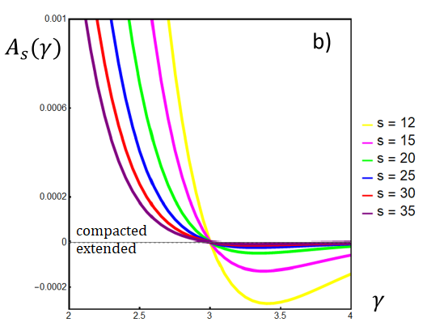
$$A_{ij }∼A_{s=\left|i−j\right|}∼\left\{\begin{aligned}\frac{c\left(γ\right)}{s^{γ}} \\ δ_{s0}+δ_{s1} \end{aligned}\right.$$
$$γ∈(2,4)\backslash \{3\}$$
$$γ=3$$
KP, S. Nechaev, M. Tamm, arXiv:1707.07153

Slide 38
$$S_{γ}= \int_{0}^{N}{ds\left[\frac{d}{2}{\left(\frac{∂X}{∂s}\right)}^{2}+\frac{1}{4}{\int_{0}^{N}{ds^{′}{\left(X\left(s\right)−X\left(s^{′}\right)\right)}^{2} \frac{c(γ)}{{\left|s−s^{′}\right|}^{γ}}}}^{}\right]}≈\frac{1}{2}\sum_{ij}^{N}{b_{ij}x_{i}x_{j}}$$
$$S_{H}= \frac{1}{2}\int_{0}^{N}{ds\int_{0}^{N}{ds^{′}\frac{∂X\left(s\right)}{∂s}\frac{∂X\left(s^{′}\right)}{∂s^{′}}}φ_{H}(|s−s′|)}≈−\frac{1}{2}\sum_{ij}^{N}{{\frac{∂^{2}φ_{H}(s)}{∂s^{2}}x}_{i}x_{j}}$$
Quadratic action for a subdiffusive fBm particle, $0<H<1/2$:
$$t$$
$$B_{H}(t)$$
$$S_{H}≈ \frac{1}{2}\int_{0}^{N}{dt\int_{0}^{N}{dt^{′}\frac{∂X\left(t\right)}{∂t}\frac{∂X\left(t^{′}\right)}{∂t′}}\frac{1}{{\left|t−t^{′}\right|}^{2/d_{f}}}}$$

Slide 39
$$S_{γ}= \int_{0}^{N}{ds\left[\frac{d}{2}{\left(\frac{∂X}{∂s}\right)}^{2}+\frac{1}{4}{\int_{0}^{N}{ds^{′}{\left(X\left(s\right)−X\left(s^{′}\right)\right)}^{2} \frac{c(γ)}{{\left|s−s^{′}\right|}^{γ}}}}^{}\right]}≈\frac{1}{2}\sum_{ij}^{N}{b_{ij}x_{i}x_{j}}$$
$$S_{H}= \frac{1}{2}\int_{0}^{N}{ds\int_{0}^{N}{ds^{′}\frac{∂X\left(s\right)}{∂s}\frac{∂X\left(s^{′}\right)}{∂s^{′}}}φ_{H}(|s−s′|)}≈−\frac{1}{2}\sum_{ij}^{N}{{\frac{∂^{2}φ_{H}(s)}{∂s^{2}}x}_{i}x_{j}}$$
Quadratic action for a subdiffusive fBm particle, $0<H<1/2$:
$$t$$
$$B_{H}(t)$$
$$S_{H}≈ \frac{1}{2}\int_{0}^{N}{dt\int_{0}^{N}{dt^{′}\frac{∂X\left(t\right)}{∂t}\frac{∂X\left(t^{′}\right)}{∂t′}}\frac{1}{{\left|t−t^{′}\right|}^{2/d_{f}}}}$$
$$F_{α=2H }≈−\int_{0}^{t}{dt^{′}\frac{1}{{\left|t−t^{′}\right|}^{α}}\frac{∂X(t^{′})}{∂t′}}$$
FLE friction force:

Slide 40
Application to chromatin dynamics
Overdamped limit, $m≪1$:
$${−F}_{fr}^{n}=F_{cons}^{n}+F_{R}^{n}$$
$$F_{cons}^{n}=\sum_{i≠n}{A_{in}(x_{i}−x_{n})}$$
1. Newtonian fluid
$F_{fr}^{n}=ξx_{n}′$;
$$F_{R}^{n}\left(t\right)F_{R}^{n^{′}}\left(t^{′}\right)=2dk_{B}Tδ\left(n−n^{′}\right)δ(t−t′)$$
Set of Ornshtein-Uhlenbeck oscillators:
$$ξu_{p}=−λ_{p}u_{p}+f_{p}$$
$$τ_{p}=τ_{N}{\left(\frac{N}{p}\right)}^{β}$$
Set of relaxation times:
($β$-model)
$$β=1+2/d_{f}$$
$$\left\langle x_{n}^{2}(t)\right\rangle ∼t^{\frac{2}{d_{f}+2}}$$
$$\left\langle {\left(x_{n}−x_{m}\right)}^{2}\right\rangle ∼{\left|n−m\right|}^{2/d_{f}}$$
A. Amitai, D. Holcman, PRE, 2013

Slide 41
Application to chromatin dynamics
Overdamped limit, $m≪1$:
$${−F}_{fr}^{n}=F_{cons}^{n}+F_{R}^{n}$$
$$F_{cons}^{n}=\sum_{i≠n}{A_{in}(x_{i}−x_{n})}$$
2. Viscoealstic fluid
$$F_{fr}^{n}=\int_{0}^{t}{dτ K_{α}(t−τ)\frac{∂x_{n}(τ^{′})}{dτ′}}$$
$$F_{R}^{n}\left(t\right)F_{R}^{n}\left(t^{′}\right)=K_{α} (t−t′)$$
$$K_{α}(t)=D_{α}\frac{(2−α)(1−α)}{t^{α}}$$
KP, M. Cosentino-Lagomarsino, M. Gherardi, M. Tamm, PRL 2017 (submitted)

Slide 42
Application to chromatin dynamics
Overdamped limit, $m≪1$:
$${−F}_{fr}^{n}=F_{cons}^{n}+F_{R}^{n}$$
$$F_{cons}^{n}=\sum_{i≠n}{A_{in}(x_{i}−x_{n})}$$
2. Viscoealstic fluid
$$F_{fr}^{n}=\int_{0}^{t}{dτ K_{α}(t−τ)\frac{∂x_{n}(τ^{′})}{dτ′}}$$
$$F_{R}^{n}\left(t\right)F_{R}^{n}\left(t^{′}\right)=K_{α} (t−t′)$$
$$K_{α}(t)=D_{α}\frac{(2−α)(1−α)}{t^{α}}$$
$$\left\langle x_{n}^{2}(t)\right\rangle ∼t^{\frac{2α}{d_{f}+2}}$$
$$\left\langle {\left(x_{n}−x_{m}\right)}^{2}\right\rangle ∼{\left|n−m\right|}^{2/d_{f}}$$
KP, M. Cosentino-Lagomarsino, M. Gherardi, M. Tamm, PRL 2017 (submitted)

Slide 43
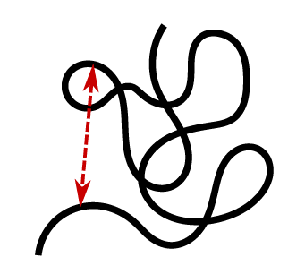
Application to chromatin dynamics
Chain packing and viscoelasticity jointly affect dynamics of chromatin.
In order to disentangle these effects and determine both the fractal dimension of
the packing and viscoelasticity of the medium, we suggest a following
quantity to be measured in a two-loci tracking experiment:
$$x_{n}$$
$$G\left(n−m, t\right)= \left\langle x_{nm}\left(t\right)x_{nm}\left(0\right)\right\rangle$$
$$x_{nm}$$
$$x\left(t\right)=x_{n}\left(t\right)−x_{m}\left(t\right)$$
$$x_{m}$$

Slide 44
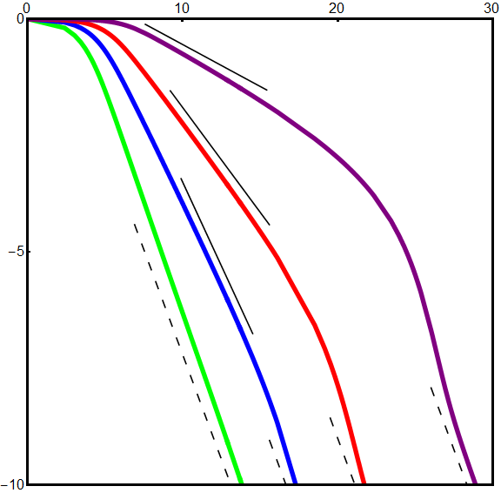
Application to chromatin dynamics
$$\ln{G(s,t)}$$
Characteristic time of stress propagation
$$t∼s^{β/α}$$
Two regimes of $G(s, t)$ as $t$-function:
$s^{β/α}≪t≪N^{β/α}$
$G\left(s, t\right)∼\frac{1}{t^{α\left(\frac{3}{β}−1\right)}}$
$t≫N^{β/α}$
$G\left(s, t\right)∼\frac{1}{t^{α}}$
$$α=0.9$$
$$β=2.5$$
$$β=2$$
$$β=5/3$$
$$β=4/3$$
$$\ln{t}$$
KP, M. Cosentino-Lagomarsino, M. Gherardi, M. Tamm, PRL 2017 (submitted)

Slide 45
FBM action
$$S_{H}≈ \frac{1}{2}\int_{0}^{N}{dt\int_{0}^{N}{dt^{′}\frac{∂X\left(t\right)}{∂t}\frac{∂X\left(t^{′}\right)}{∂t′}}\frac{1}{{\left|t−t^{′}\right|}^{2H}}}$$
Gaussian approximation for the fBm action allows to take into account for both effects
of chain folding (fractal dimension $({2≤ d}_{f}≤ 3$) and viscoelasticity of the
medium.

Slide 46
Acknowledgements
Mike Tamm
Sergei Nechaev
Ralf Metzler
Denis Grebenkov
Gleb Oshanin
Yitzhak Rabin
Marco Cosentino-Lagomarsino
Marco Gherardi
…

