Slide 1
Rouse-like dynamics of the topologically stabilized polymer states
Mikhail TAMM,
Physics Department, Moscow State University and
Department of Applied Mathematics, Higher School of Economics
Moscow, Russia
Saint Petersburg, September, 20, 2017

Slide 2
Outline
What are the “topologically stabilized states” and what is their biological relevance?
Generalized Rouse model for the dynamics of these states: scaling approach for the Newtonian and viscoelastic environment, and calculation of the correlation functions within the beta model.

Slide 3
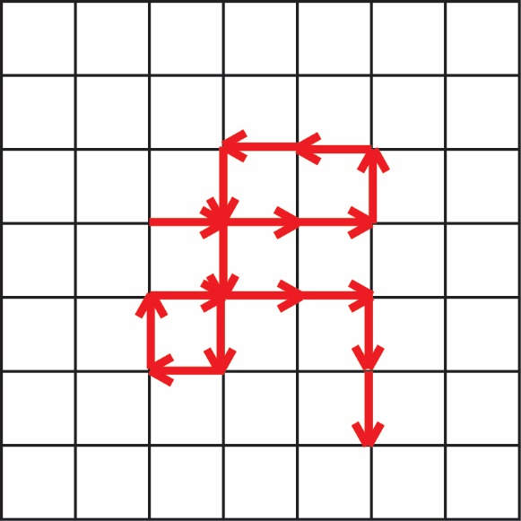
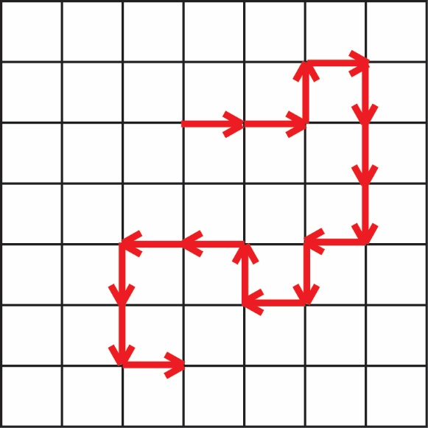
Classical polymer physics
To describe the conformation statistics of linear polymer chains one needs to understand these two processes:
Standard random walk Self-avoiding walk

Slide 4
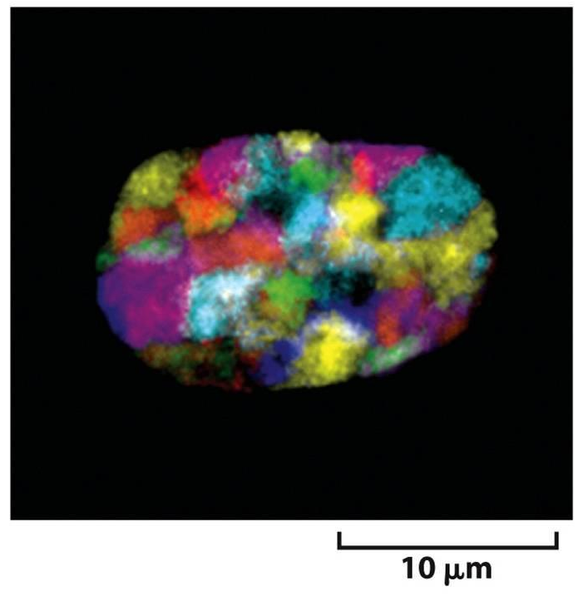
Chromosome territories
M.P. Speicher, N.P. Carter, Nat. Rev. Gen., 2005

Slide 5
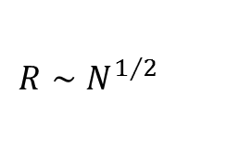
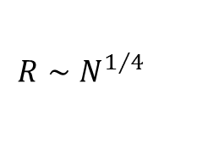
Polymer rings can behave differently
$$R∼N^{1/2}$$
$$R∼N^{1/4}$$
A. Khokhlov, S. Nechaev, 1985.
Topological interactions and non-phantomness of the chains become important!

Slide 6
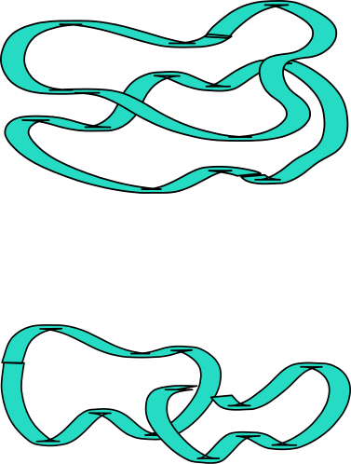
Topological repulsion of the rings
Unknotted rings remain unknotted, and non-concatenated rings remain non-concatenated forever. This reduces their phase space, and induces topological repulsion between rings. Contrary to usual volume interactions this topological repulsion is not screened even in the melt.

Slide 7
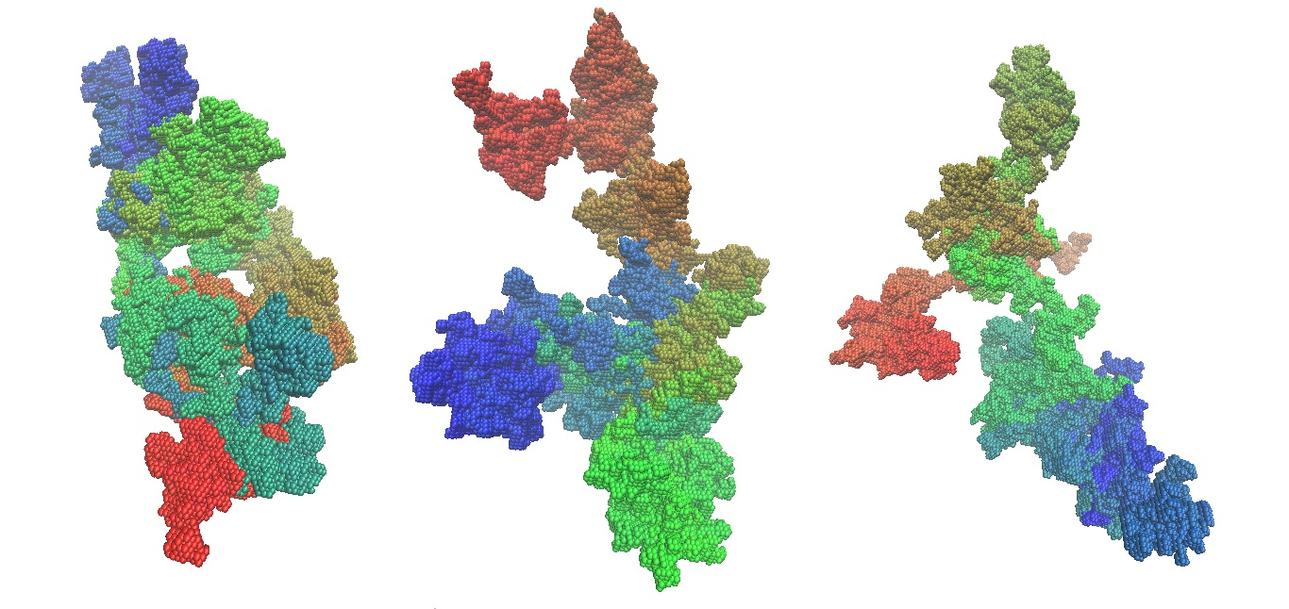
Non-concatenated rings in the melt
Rings take compact conformations with very developed surface
M. Cates, J. Deutsch, 1986;…; T. Sakaue, 2011; A. Grosberg, 2014; S. Obukhov et al., 2014; T. Ge et al., 2016

Slide 8
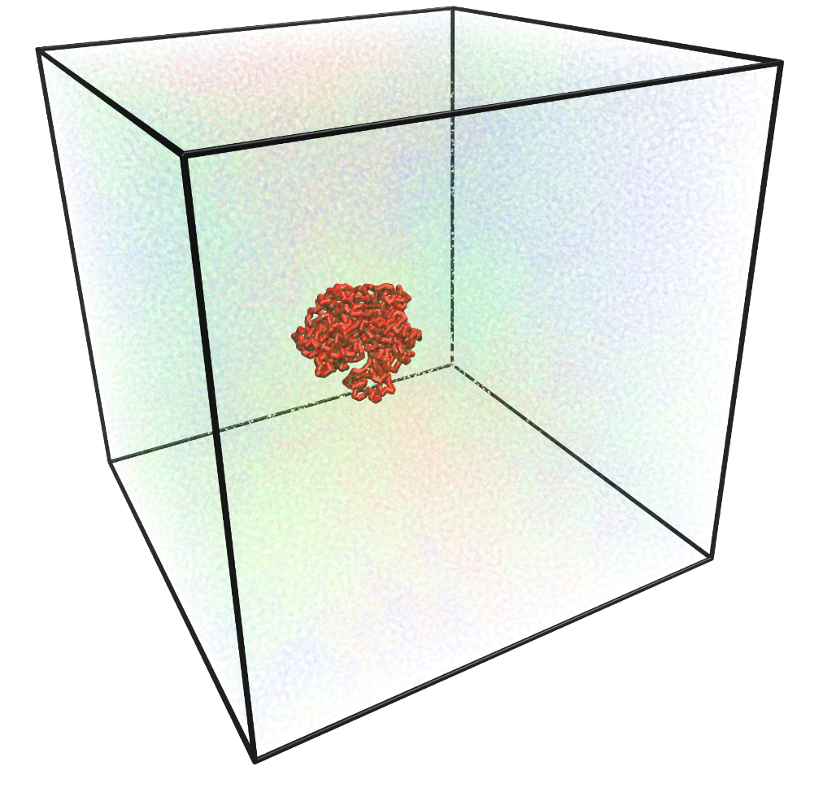
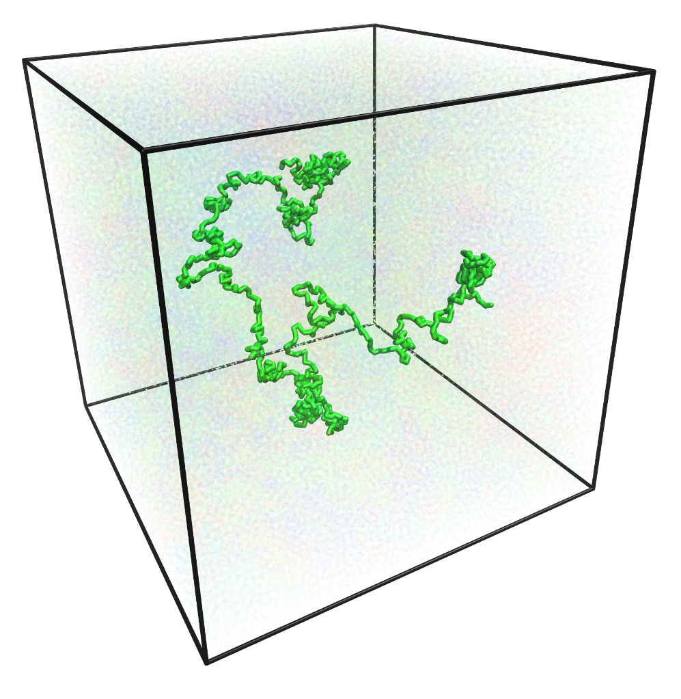
Conformations of a chain in a melt
Subdomain of a topologically
collapsed chain
Subdomain of an equilibrium
linear chain

Slide 9
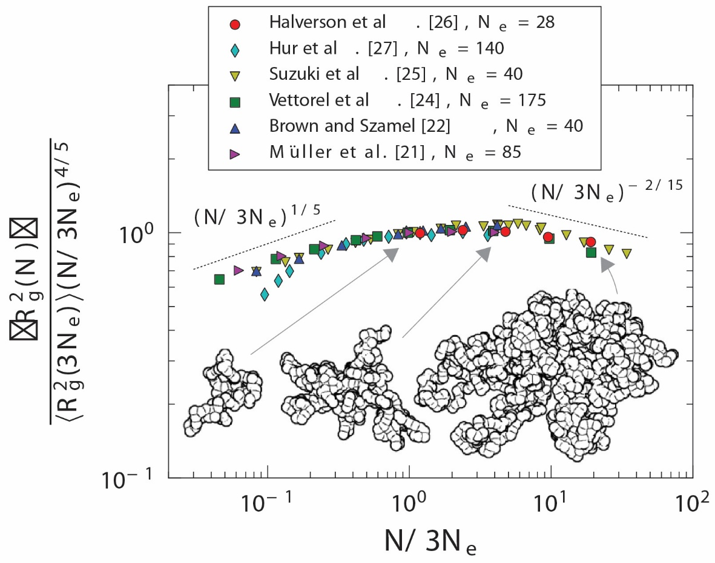
Non-concatenated rings in the melt
Conformation statistics of rings is universal and asymptotically compact with fractal dimension 3; although convergence is very slow.
J. Halverson, G. Crest, A. Grosberg, K. Kremer, PRL, 2012

Slide 10
Non-concatenated rings in the melt
Large scale statistics of rings in a melt seems non-distinguishable from the melts of annealed randomly branched polymers
A. Rosa, R. Everaers, 2014; J. Smrek, A. Grosberg, 2016; R. Everaers et al., 2017…

Slide 11
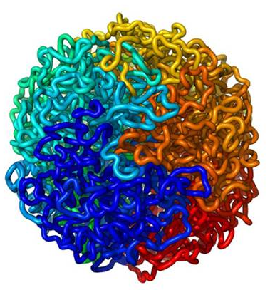
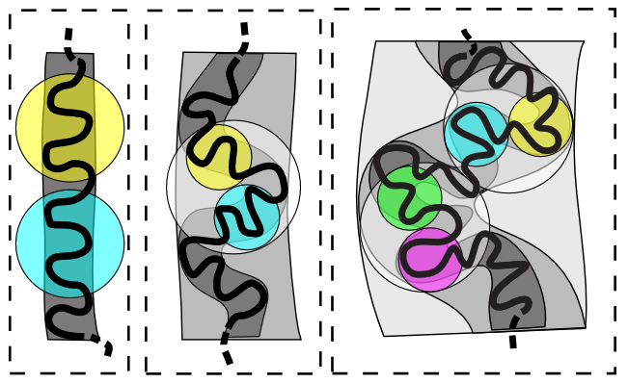
Other examples of similar states: crumpled globule
Rapid collapse of a linear polymer chains: formation of entanglements is kinetically suppressed
A. Grosberg, S. Nechaev, E. Shakhnovich, 1988
E. Lieberman-Aiden et al., 2009; L. Mirny, 2011
Suggested as a hypothetical intermediate state in rapid polymer collapse. Self-similar set of crumples on all length scales, monomers close along the chain are close in space.

Slide 12
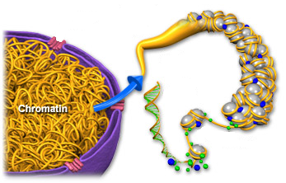
High-level chromatin organization:
chromatin fiber
nucleosomes
DNA helix
histones
M.P. Speicher, N.P. Carter, Nat. Rev. Gen., 2005
Even linear chains, if prepared in unknotted state, will take conformations similar to topologically stabilized ones, and remain in these conformations up to the time needed for knots to form, which might be up to 500 years for chromatin.

Slide 13

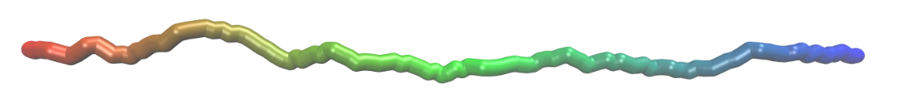

Crumpled globule state
stable for unknotted rings only, long living meta-stable for linear chains
compact structure
distinct domain organization
developed domain surface
no or few entanglements
fractal dimension = 3
return probability
$$P\left(s\right)∼s^{−2+β}≈s^{−1.09}$$

Slide 14
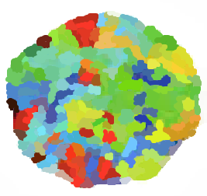
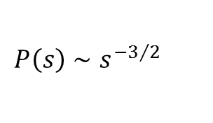
Equilibrium linear polymer globule
thermodynamically stable state
compact structure
no distinct domains
lots of entanglements
not fractal as a whole, short chain fragments have fractal dimension = 2
$$P\left(s\right)∼s^{−3/2}$$

Slide 15
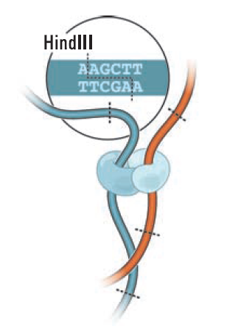
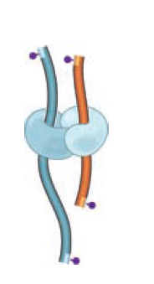
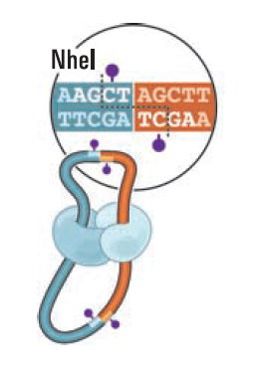
Hi-C method
1
2
3
Lieberman-Aiden et al. Science. 2009 Oct 9;326(5950):289-93.

Slide 16
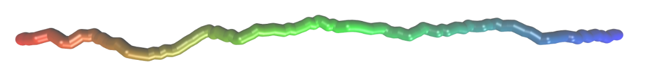
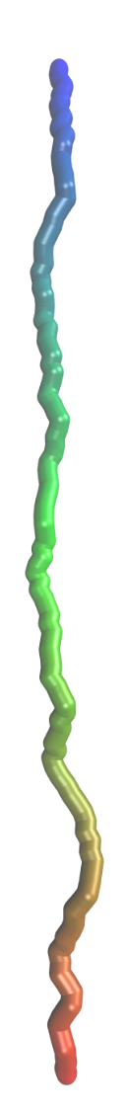
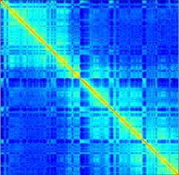
Chromatin packing geometry from Hi-C maps
1
i
j
N
0
P
ij
Contact probability scale
0.5
i
j
1

Slide 17
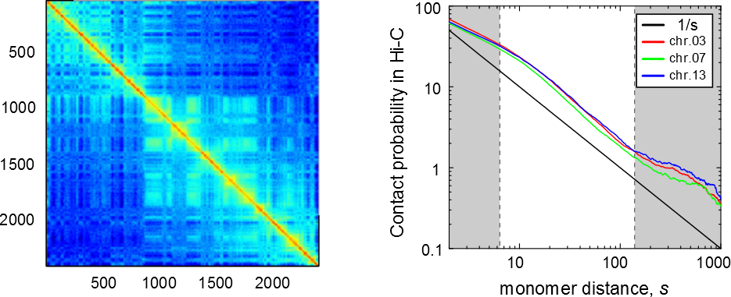
Hi-C maps:
contact probability vs. genomic distance
Chromosome 13
The contact probability decays approximately as 1/(genomic distance) in most cases. This decay is very different from what one expects in an equilibrium polymer globule, but is reminiscent of the fractal globule state.

Slide 18
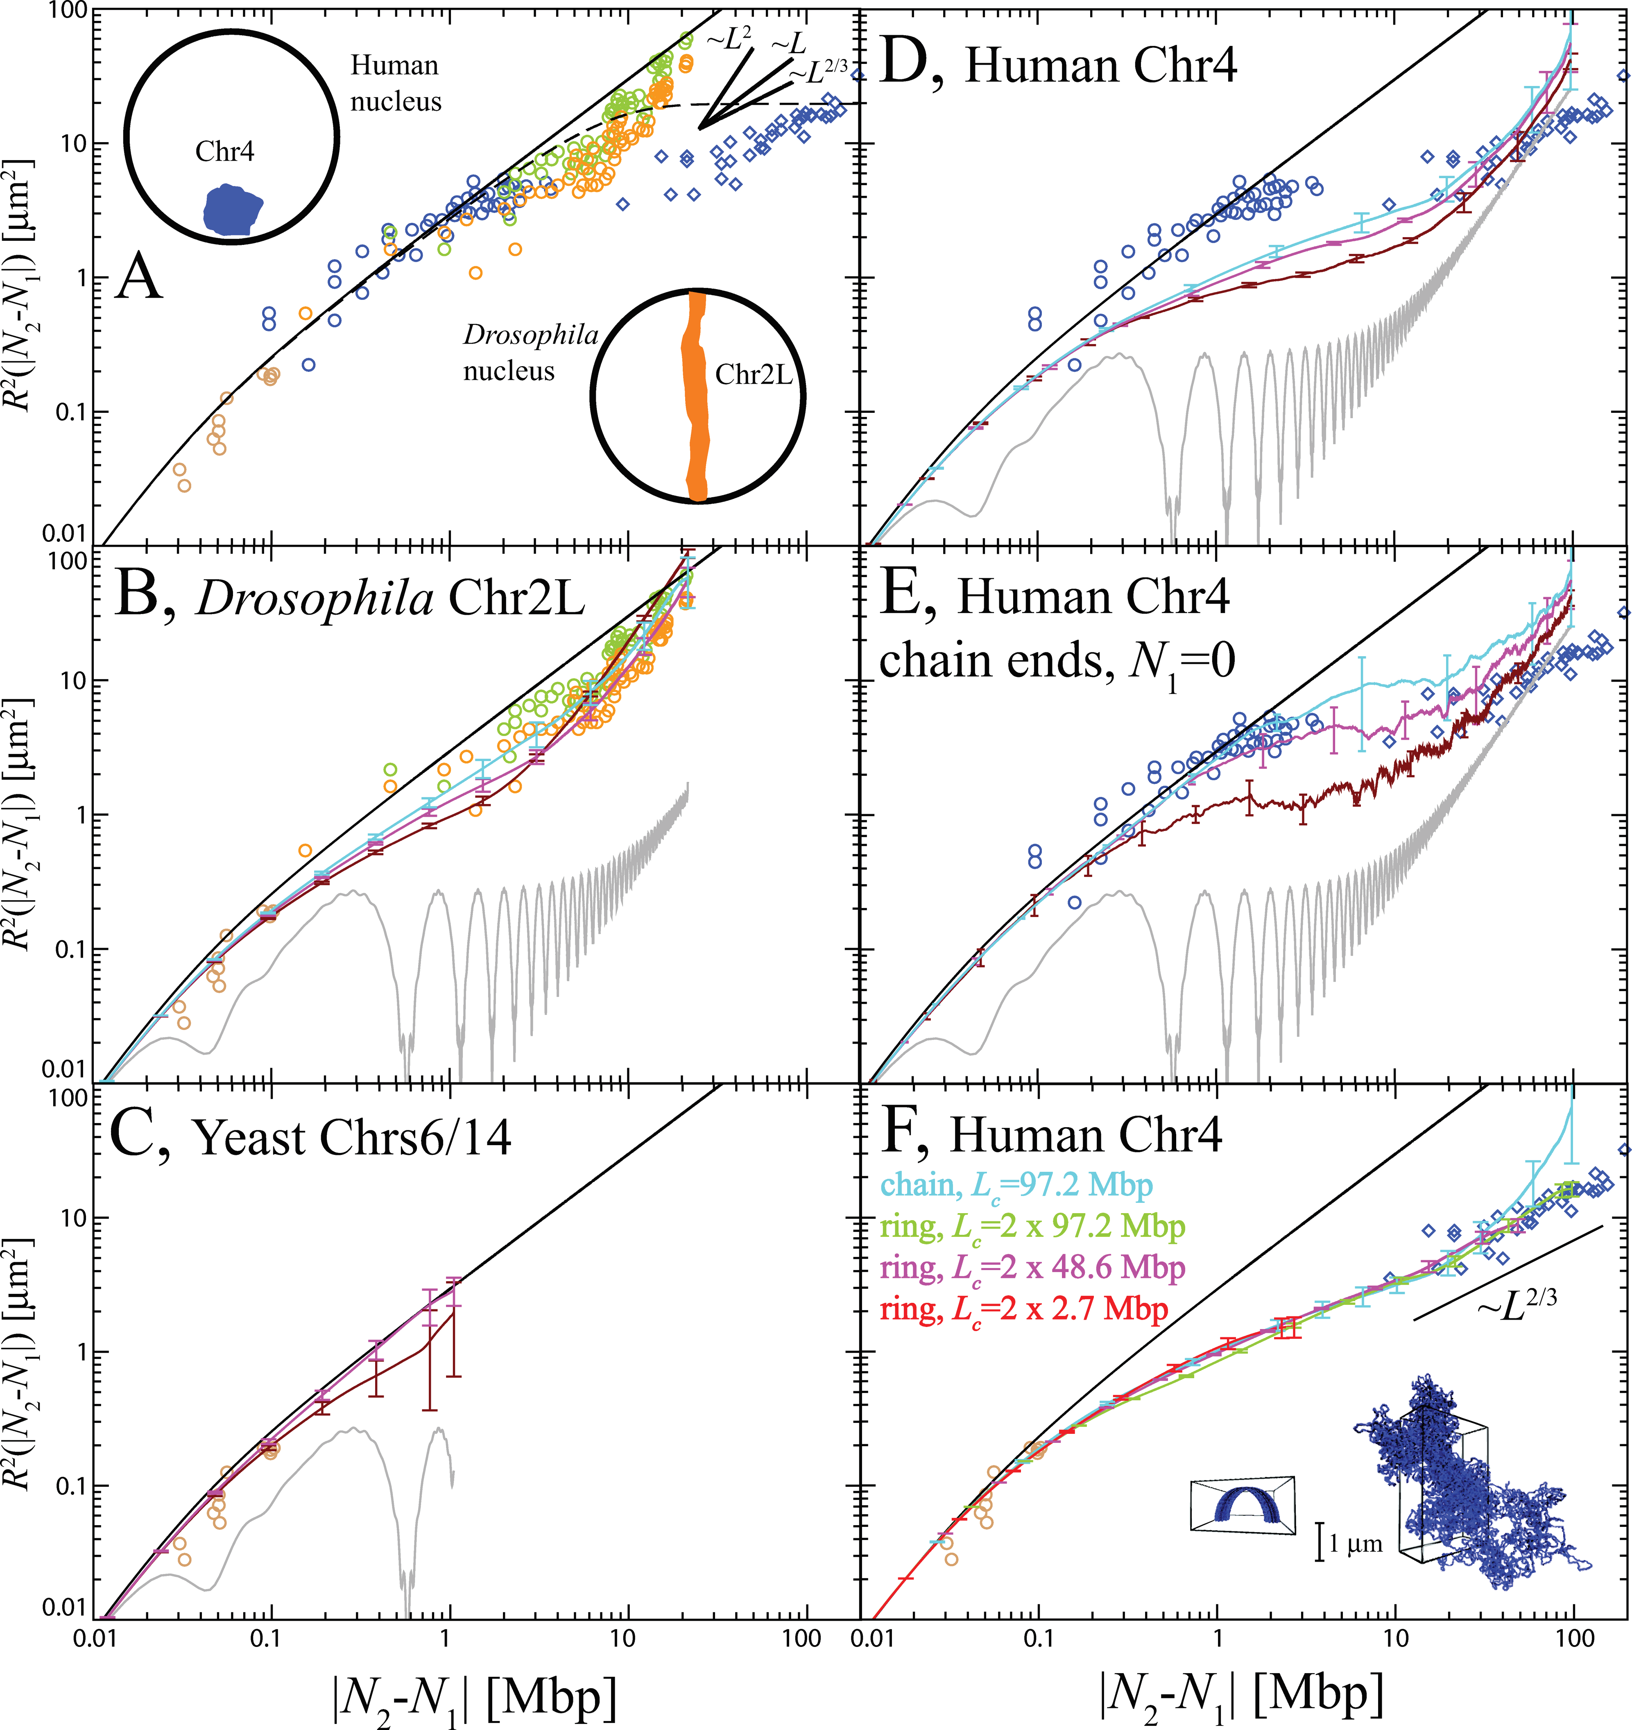
FISH data on chromosome conformations
Results of the FISH experiments can be nicely fitted by computer simulations of unknotted initial conformations relaxed up to biological timescales
A. Rosa, R. Everaers, 2008.

Slide 19
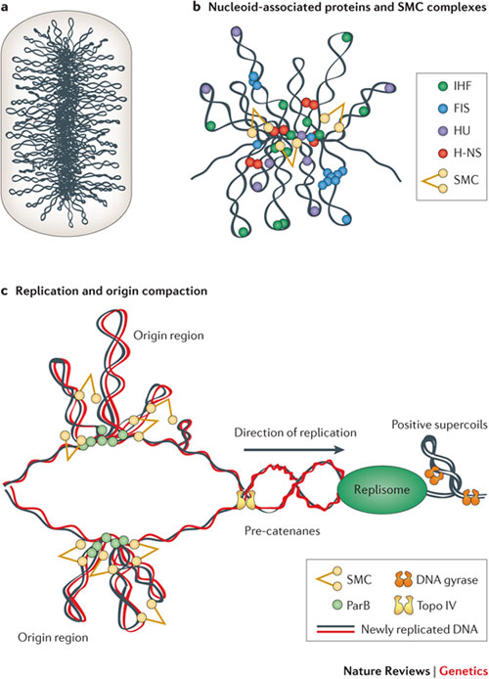
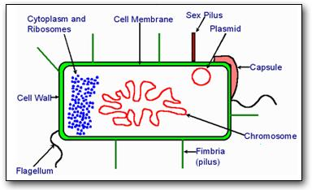
Other examples of fractal globule states:
Bacterial chromosome?

Slide 20
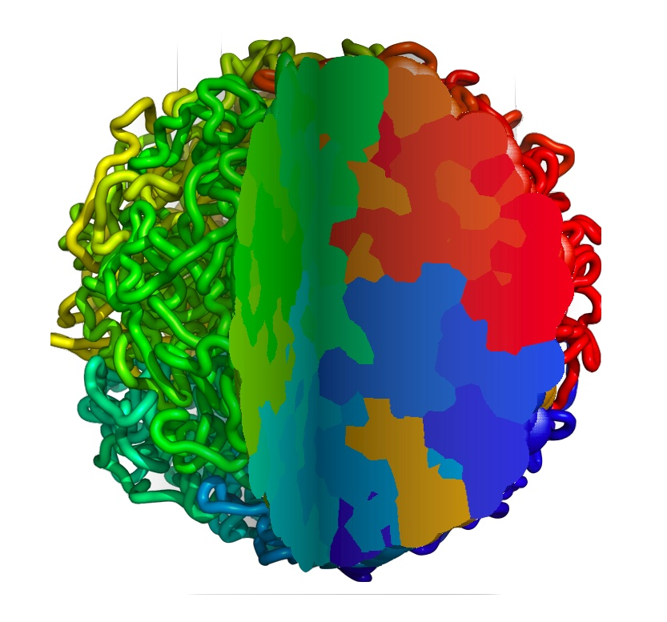
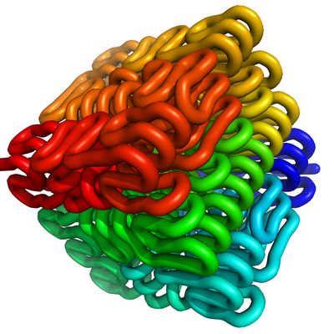
Other examples of fractal globule states:
Peano curve after annealing
Domains in crumpled globule have very developed surface, they are interpenetrating

Slide 21
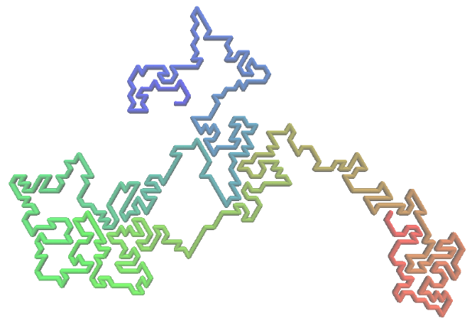
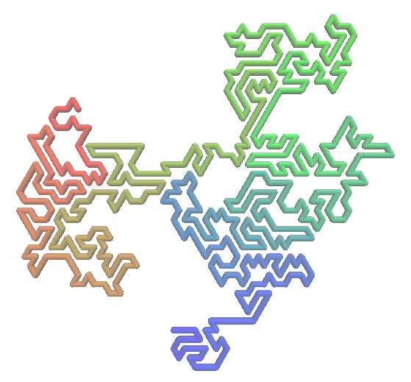
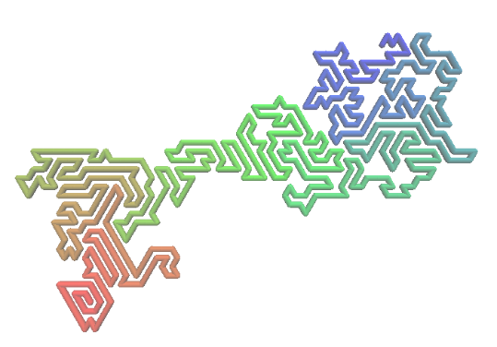
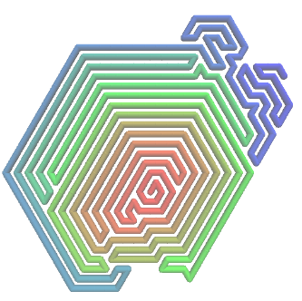
Other examples of fractal globule states: self-reinforced random walk
Random walk, whose new steps ‘like’ to stick to the already visited places:
A.
B.
Here the “stickiness parameter” increases from A to D
C.
D.
Nothing especially interesting happens in 2D, but it is because knots cannot form here anyway. In 3D and with large stickiness, one expects the structure to be compact on all intermediate stages, leaving no holes in a globule to form a knot.

Slide 22
Other examples of fractal globule states: self-reinforced random walk
The surface area grows as , which is, up to the margin of error, the same as known results for ring melts.

Slide 23
Are all these conformations statistically the same?

Slide 24
How to describe dynamics of the topologically constrained state?

Slide 25
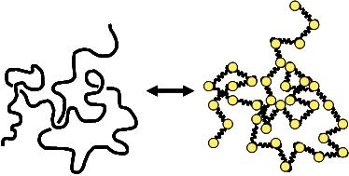
What one can say about dynamics?
The most basic and simple model of polymer dynamics is the so-called Rouse model: the chain is replaced by a set of beads and connecting springs; each bead feels a random thermal force independent from all the others.
Rouse model is known to work well if the hydrodynamic interactions are screened and if there dynamics is not suppressed by topological entanglements of the chains.
Importantly, at long time limit of the Rouse chain dynamics is an ideal polymer chain conformation (i.e., standard Brownian random walk).

Slide 26
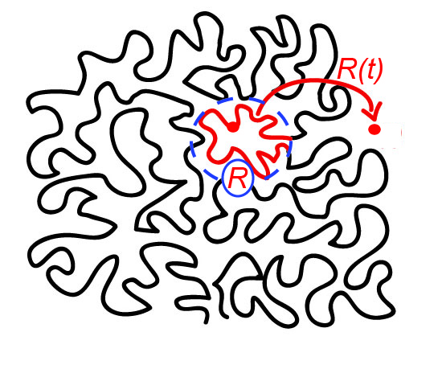
Rouse model in a nutshell
One can think of a Rouse model as a set of simultaneously evolving “Rouse modes”, each with its own characteristic timescale τ and wavelength R.
Here s is the number of monomers moving collectively in the mode with wavelength R. The effective diffusion coefficient D is inversely proportional to s because friction is assumed to be independent on all monomers. It is easy to infer from here that

Slide 27
Rouse model in a nutshell
One can think of a Rouse model as a set of simultaneously evolving “Rouse modes”, each with its own characteristic timescale τ and wavelength R.
Here s is the number of monomers moving collectively in the mode with wavelength R. The effective diffusion coefficient D is inversely proportional to s because friction is assumed to be independent on all monomers. It is easy to infer from here that

Slide 28
Modified Rouse for crumpled globule
In order to describe crumpled globule or any other fractal conformation of a polymer chain in a Rouse-like way we should therefore modify argument as follows
Here fractal dimension of packing is introduced (it equals 2 for Gaussian chain, 3 for crumpled globule). We get in the general case
M.T., L. Nazarov, A. Gavrilov, A. Chertovich,
PRL, 2015
For crumpled globule

Slide 29
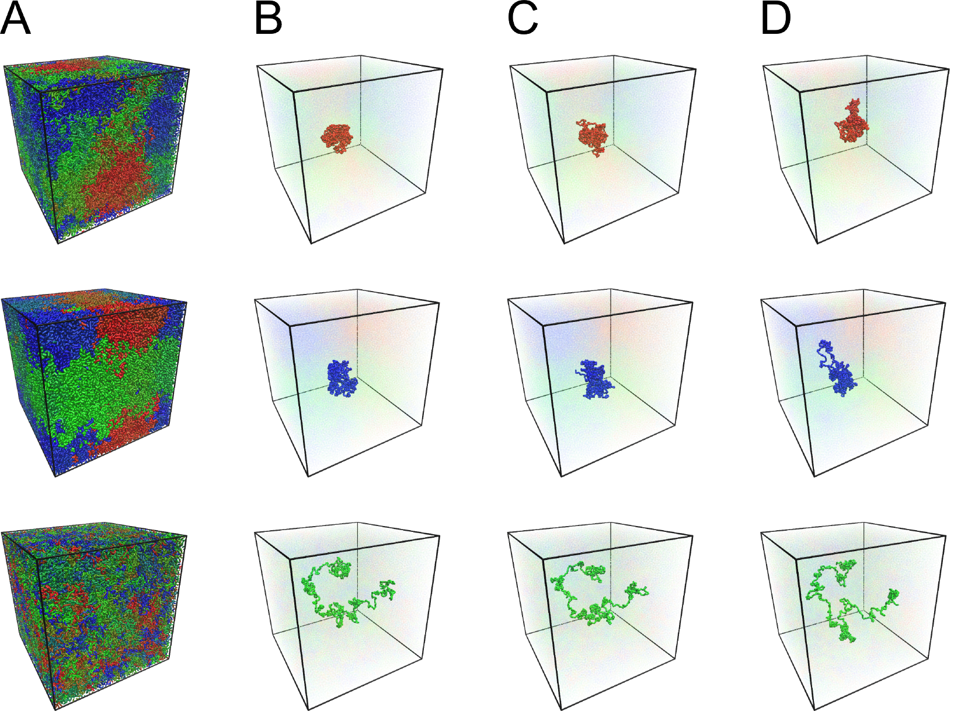
Computer simulation
M.T., L. Nazarov, A. Gavrilov, A. Chertovich,
PRL, 2015

Slide 30
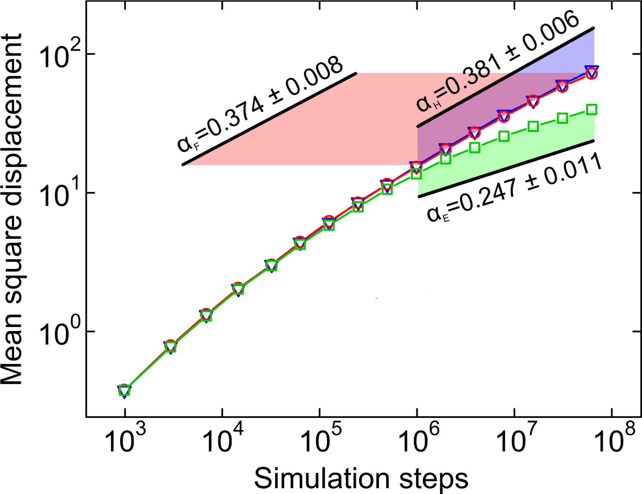
Computer simulation
(reptation theory predicts 0.25)
M.T., L. Nazarov, A. Gavrilov, A. Chertovich,
PRL, 2015

Slide 31
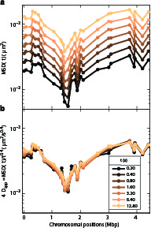
Experimental evidence
I. Bronstein et al., PRL, 2009;
K. Burnecki et al., Biophys. Journal, 2012;
E. Kepten et al., Phys Rev E, 2013
A. Javer et al., Nature Communications, 2013

Slide 32

Do entanglements play a role?
Rouse works for melts of short linear chains. If linear chains are so long that each one overlaps with more than the so-called Kavassalis-Noolandi number equal to 10-20, entanglements start playing role and one needs to employ reptation model.
Is it relevant for nonconcatenated rings and crumpled globule?
Numerical evidence for melts of long rings shows overlaps very near to KN number, and there exist several theoretical attempts to construct reptation-like theory for rings, giving rise to subdiffusion exponents of 0.26-0.28 instead of 0.4
J. Smrek, A. Grosberg, JPCM, 2015
T. Ge, S. Panyukov, M. Rubinstein, Macromolecules, 2016
However, this problem is probably not very relevant in biological context where crumpled globule is very far from equilibrium:
M.P. Speicher, N.P. Carter, Nat. Rev. Gen., 2005

Slide 33
What if medium is viscoelastic?
It is possible to give a completely different explanation of the non-Rouse dynamics of chromatin. Namely, if the surrounding medium is itself viscoelastic (and there is some evidence to support that), then it will influence polymer dynamics as well
For example, consider a medium in which single particle obeys not usual Langevin equation of Brownian motion, but the following fractal Langevin equation
Resulting in particle mean-square displacement
S. Weber, J. Theriot, A. Spakowitz, Phys. Rev. E, 2010.

Slide 34
What if medium is viscoelastic?
Then corresponding Langevin equation for a monomer being a part of a Rouse polymer chain will read
with the same noise and memory kernel.
Solving this equation leads to the following result for the monomer mean-square displacement:
S. Weber, J. Theriot, A. Spakowitz, Phys. Rev. E, 2010.

Slide 35
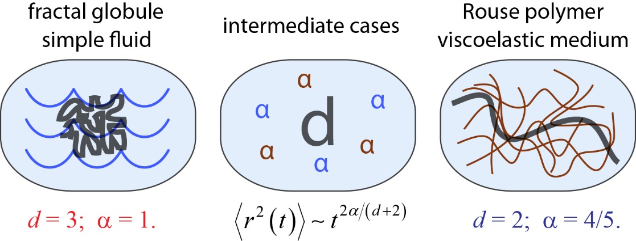
What if medium is viscoelastic?

Slide 36
Viscoelastic media
Rouse model in viscoelastic media can still be understood in terms of simultaneous relaxation of the Rouse modes, one just needs to take into account that modes are relaxing subdiffusively:
It is easy to recover the main result from here

Slide 37
Combining viscoelastic and crumpled globule
Clearly, it is possible now to take into account both effects – non-Gaussian packing of the chain and viscoelasticity of the surrounding medium - simultaneously:
From here the relaxation times and MSD for a crumpled globule in viscoelastic medium can be easily recovered:
M.T., K. Polovnikov, M. Gherardi, M. Cosentino Lagomarsino, arxiv:1703.10841.

Slide 38
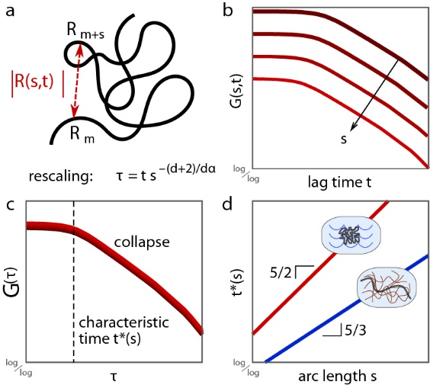
Combining viscoelastic and crumpled globule
The “characteristic time” τ plays a role of variable you use to renormalize time with in order to get collapse of the correlation functions.

Slide 39
Combining viscoelastic and crumpled globule
These two exponents can be measured independently:
MSD – from single-particle tracking;
Relaxation time of a domain of given genome length – from correlation functions in simultaneous two-particle tracking
Having these two exponents simultaneously for the same system allows to infer both parameters. For example
M.T., K. Polovnikov, M. Gherardi, M. Cosentino Lagomarsino, in preparation.

Slide 40
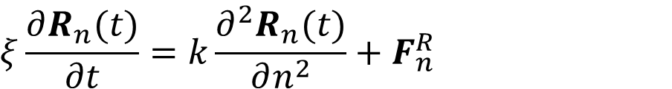
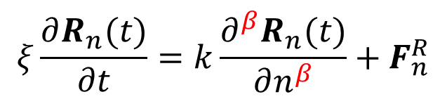
Going beyond scaling: the beta model
$$ξ\frac{∂R_{n}(t)}{∂t}=k\frac{∂^{2}R_{n}(t)}{∂n^{2}}+F_{n}^{R}$$
Change fractal dimension by changing the order of the derivative:
$$ξ\frac{∂R_{n}(t)}{∂t}=k\frac{∂^{β}R_{n}(t)}{∂n^{β}}+F_{n}^{R}$$

Slide 41
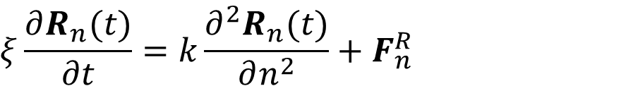

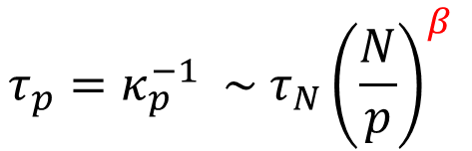
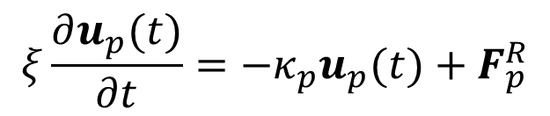

Problem 3: any chance to go beyond scaling arguments?
$$ξ\frac{∂R_{n}(t)}{∂t}=k\frac{∂^{2}R_{n}(t)}{∂n^{2}}+F_{n}^{R}$$
Change fractal dimension by changing the order of the derivative:
$$ξ\frac{∂u_{p}(t)}{∂t}=−κ_{p}u_{p}(t)+F_{p}^{R}$$
$$ξ\frac{∂R_{n}(t)}{∂t}=k\frac{∂^{β}R_{n}(t)}{∂n^{β}}+F_{n}^{R}$$
$$\left\{R_{n}\right\}→\{u_{p}\}$$
$$τ_{p}=κ_{p}^{−1} \sim {τ_{N}\left(\frac{N}{p}\right)}^{β}$$
A. Amitai and D. Holcman, Phys. Rev. E, 2013.

Slide 42
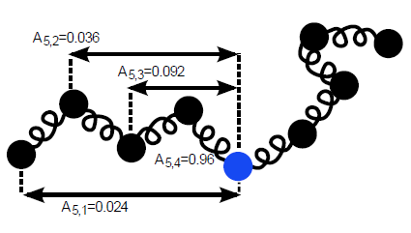


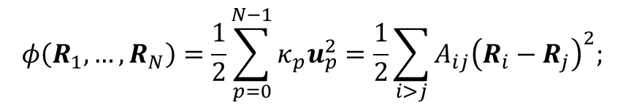

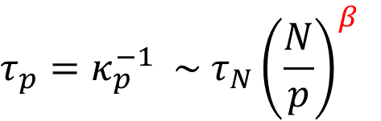
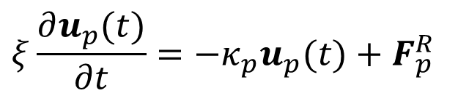
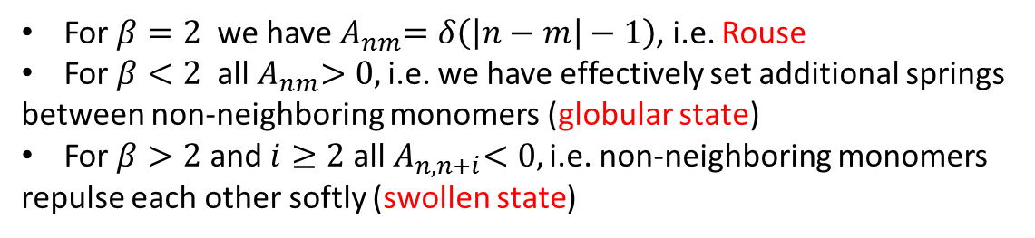
Change fractal dimension by changing the order of the derivative:
$$ξ\frac{∂u_{p}(t)}{∂t}=−κ_{p}u_{p}(t)+F_{p}^{R}$$
$$ξ\frac{∂R_{n}(t)}{∂t}=k\frac{∂^{β}R_{n}(t)}{∂n^{β}}+F_{n}^{R}$$
$$\left\{R_{n}\right\}→\{u_{p}\}$$
$$τ_{p}=κ_{p}^{−1} \sim {τ_{N}\left(\frac{N}{p}\right)}^{β}$$
$$φ\left(R_{1},…, R_{N}\right)=\frac{1}{2}\sum_{p=0}^{N−1}{κ_{p}u_{p}^{2}}=\frac{1}{2}\sum_{i>j}{A_{ij}{\left(R_{i}−R_{j}\right)}^{2};}$$
$$A_{nm}∼\frac{1}{{\left|n−m\right|}^{β+1}}$$
For $β=2$ we have${ A}_{nm}=δ\left(\left|n−m\right|−1\right)$, i.e. Rouse
For $β<2$ all${ A}_{nm}>0,$ i.e. we have effectively set additional springs
between non-neighboring monomers (globular state)
For $β>2$ and $i≥2$ all${ A}_{n,n+i}<0,$ i.e. non-neighboring monomers
repulse each other softly (swollen state)

Slide 43

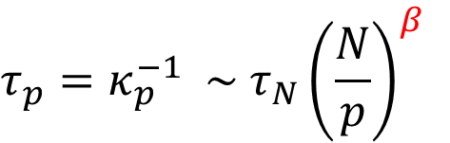
Change fractal dimension by changing the order of the derivative:
$$ξ\frac{∂u_{p}(t)}{∂t}=−κ_{p}u_{p}(t)+F_{p}^{R}$$
$$ξ\frac{∂R_{n}(t)}{∂t}=k\frac{∂^{β}R_{n}(t)}{∂n^{β}}+F_{n}^{R}$$
$$\left\{R_{n}\right\}→\{u_{p}\}$$
$$τ_{p}=κ_{p}^{−1} \sim {τ_{N}\left(\frac{N}{p}\right)}^{β}$$
How does such change of relaxation spectrum affect
fractal dimension and dynamic exponent?
$$<{(R}_{n}{−R}_{m})^{2}>\sim {\left|n−m\right|}^{2/d_{f}}$$
in the long t limit
$$<R_{n}^{2}\left(t\right)>\sim { t}^{γ}$$

Slide 44











Summary of Beta model results
In equilibrium
$$<R_{n}^{2}\left(t\right)>\sim { t}^{1−\frac{1}{β}}$$
$$<{(R}_{n}{−R}_{m})^{2}>\sim {\left|n−m\right|}^{β−1}$$
Gaussian coil
$$β=2$$
$$∼|n−m|$$
$$∼t^{0.5}$$
Crumpled globule
$$β=5/3$$
$$∼{\left|n−m\right|}^{2/3}$$
$$∼t^{0.4}$$
Swollen coil
$$β=11/5$$
$$∼{\left|n−m\right|}^{6/5}$$
$$∼t^{6/11}$$

Slide 45





Summary of Beta model results
$$<R_{n}^{2}\left(t\right)>\sim { t}^{1−\frac{1}{β}}$$
$$<{(R}_{n}\left(t\right){−R}_{m}{\left(t\right))}^{2}>\sim {\left|n−m\right|}^{β−1}$$
Also, it is easy to see that Beta model predicts that for all values of b the resulting process should be fractional Brownian motion. Indeed, from
$$ξ\frac{∂R_{n}(t)}{∂t}=k\frac{∂^{β}R_{n}(t)}{∂n^{β}}+F_{n}^{R}$$
$$R_{n}\left(t\right)=L[F_{i}^{R}]$$
Is a result of some linear operator acting on a Gaussian noise
$$R_{n}(t)$$
is Gaussian
$$R_{n}(t)$$
is fractal Brownian motion

Slide 46





Beta model in viscoelastic environment
In real biological systems the chromosome loci move in a very crowded environment, therefore it is crucial to allow for the viscoelasticity of the medium. It is easy to combine beta-model of chain connectivity with fractal Langevin equation for the noise and memory kernel acting on a single monomer, getting:
$$ξ\int_{0}^{t}{dt^{′}K\left(t−t^{′}\right)\frac{∂R_{n}\left(t^{′}\right)}{∂t^{′}}=}k\frac{∂^{β}R_{n}(t)}{∂n^{β}}+F_{n}^{R}$$
$$<F_{n}^{R}\left(t\right)F_{m}^{R}\left(t^{′}\right)> =ξdk_{B}TK\left(t−t^{′}\right)δ_{pp′}$$
$$K\left(y\right)\sim \frac{1}{y^{α}}$$
$$0<α≤1$$
$$1<β<3$$
MT, K. Polovnikov, M. Gherardi, M. Cosentino Lagomarsino, in preparation.

Slide 47







Beta model in viscoelastic environment
In real biological systems the chromosome loci move in a very crowded environment, therefore it is crucial to allow for the viscoelasticity of the medium. It is easy to combine beta-model of chain connectivity with fractal Langevin equation for the noise and memory kernel acting on a single monomer, getting:
$$ξ\int_{0}^{t}{dt^{′}K\left(t−t^{′}\right)\frac{∂R_{n}\left(t^{′}\right)}{∂t^{′}}=}k\frac{∂^{β}R_{n}(t)}{∂n^{β}}+F_{n}^{R}$$
$$<F_{n}^{R}\left(t\right)F_{m}^{R}\left(t^{′}\right)> =ξdk_{B}TK\left(t−t^{′}\right)δ_{pp′}$$
$$<{(R}_{n}\left(t\right){−R}_{m}{\left(t\right))}^{2}>\sim {\left|n−m\right|}^{β−1}$$
$$<R_{n}^{2}\left(t\right)>\sim { t}^{α\left(1−\frac{1}{β}\right)}$$
$$K\left(y\right)\sim \frac{1}{y^{α}}$$
$$0<α≤1$$
$$1<β<3$$
MT, K. Polovnikov, M. Gherardi, M. Cosentino Lagomarsino, in preparation.

Slide 48



Beta model in viscoelastic environment: two-point correlation function.
Chain packing and viscoelasticity jointly affect dynamics of chromatin.
In order to disentangle these effects and determine both the fractal dimension of
the packing and viscoelasticity of the medium, we suggest a following
quantity to be measured in a two-loci tracking experiment:
$$G\left(|n−m|, t\right)= <R_{nm}\left(t\right)R_{nm}\left(0\right)> ∼$$
$$∼−\frac{a^{2}}{2}{\left(\frac{2}{π}\right)}^{β}{\left|n−m\right|}^{β−1}\sum_{k=1}^{∞}{\frac{{\left(−1\right)}^{k}π^{2k}}{\left(2k\right)!}{}_{2}^{}{ψ_{2}\left[−\frac{t^{α}}{{\left|n−m\right|}^{β}}|\begin{matrix}\left(ρ, β\right),(1, 1) \\ \left(1,α\right),(1+ρ,β)\end{matrix}\right]}}$$
$${}_{p}^{}{ψ_{q}\left[z | \begin{matrix}{\left(a_{l} α_{l}\right)}_{1,p} \\ {\left(b_{j},β_{j}\right)}_{1,q}\end{matrix}\right]≔\sum_{k=0}^{∞}{\frac{\prod_{l=1}^{p}{Γ\left(a_{l}+α_{l}k\right)}}{\prod_{j=1}^{q}{Γ(b_{j}+β_{j}k)}}\frac{z^{k}}{k!}}}$$
Generalized
Wright-Fox function

Slide 49


Beta model in viscoelastic environment: two-point correlation function.
$G(s, t)$ as a function of $t$ has
two asymptotic regimes, if $β>\frac{3}{2}$:
$s^{β/α}≪t≪N^{β/α}$
$G\left(s, t\right)∼\frac{1}{t^{α\left(\frac{3}{β}−1\right)}}$
$t≫N^{β/α}$
$G\left(s, t\right)∼\frac{1}{t^{α}}$

Slide 50
Take home message
There can be many factors governing subdiffusive dynamics of chromosomes, the local spatial packing geometry and the properties of the surrounding media being ones of the most important.
Luckily, with enough experimental data (in particular, the data on two-point correlation functions) it should be possible to disentangle the effects of different factors and measure them separately.

Slide 51







Thanks to the collaborators
- Leonid Nazarov
- Kirill Polovnikov
- Alexey Gavrilov
- Alexander Chertovich
- Sergei Nechaev
- Marco Cosentino Lagomarsino
- Marco Gherardi

